Slide 1
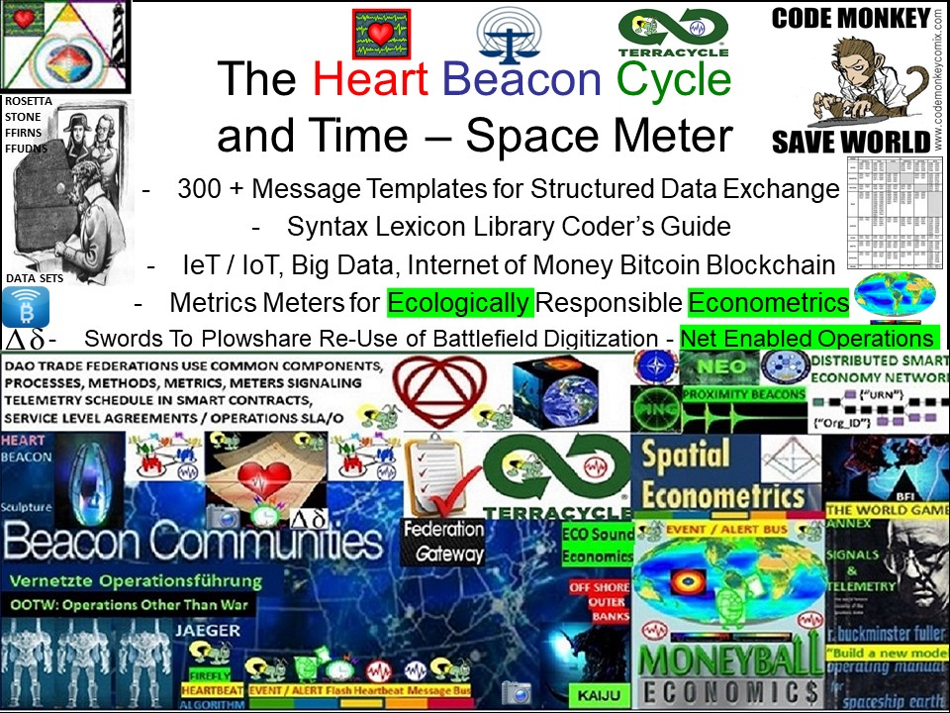

Slide 2
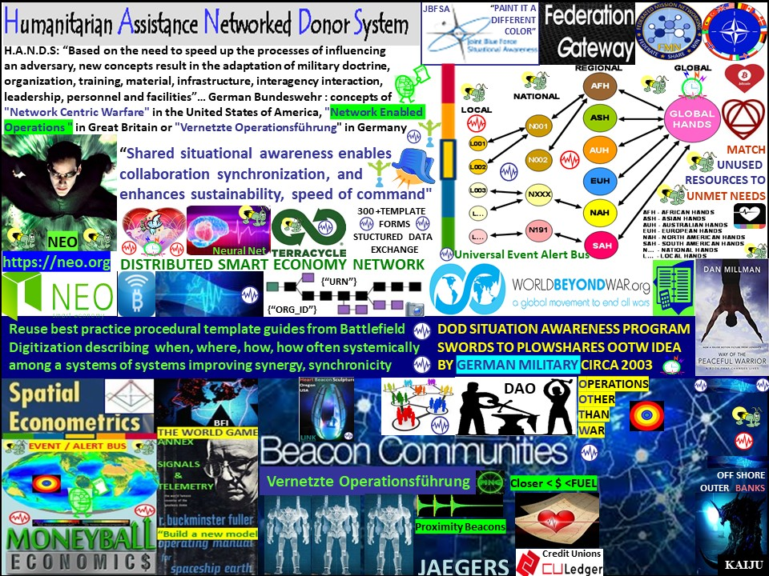

Slide 3
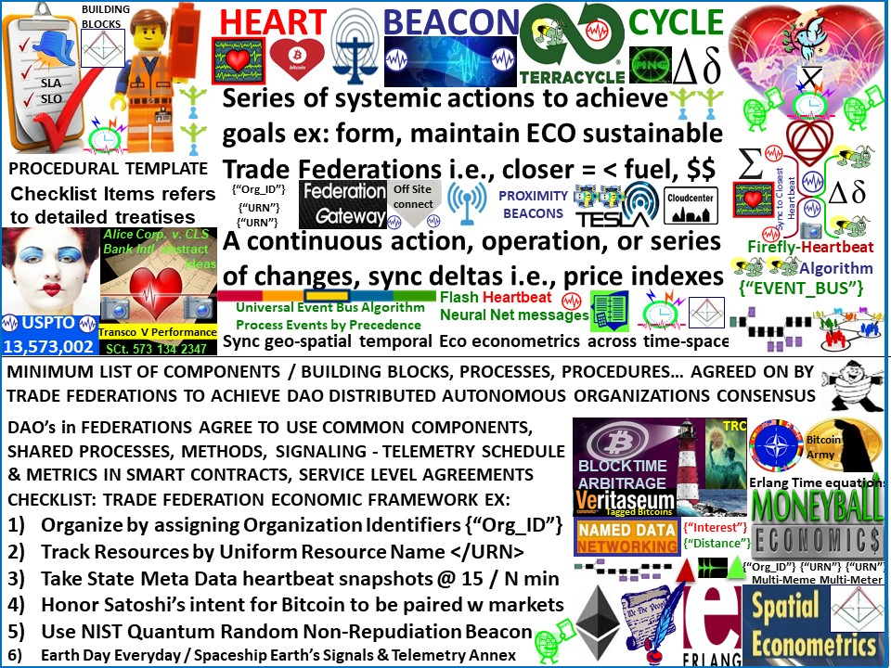
Notes:
The Heart Beacon Cycle is a procedural template framework that includes citations of required standards, processes, shared components / building blocks and conventions that are agreed upon as criteria required as a minimum to join a federation (cloud computing term). Individual entries to the procedural template checklist -- a clipboard of things needed, to do items if you will point to detailed treatises. A process defines “what” needs to be done and which roles are involved A procedure defines “how” to do the task. A process consists of the following:
• Roles and responsibilities of the people (roles) assigned to do the work
• Appropriate tools and equipment to support individuals in doing their jobs
• Procedures and methods defining “how” to do the tasks and relationships between the task.
Capability Maturity Model Integration (CMMI) V1.2: • In the CMMI Product Suite, activities that can be recognized as implementations of practices in a CMMI model. These activities can be mapped to one or more practices in CMMI process areas to allow a model to be useful for process improvement and process appraisal. (See also “process area,” “sub process,” and “process element.” Process Description (as defined by the CMMI V1.2):
• A documented expression of a set of activities performed to achieve a given purpose.
• A process description provides an operational definition of the major components of a process. The description specifies, in a complete, precise, and verifiable manner, the requirements, design, behavior, or other characteristics of a process. It also may include procedures for determining whether these provisions have been satisfied. Process descriptions can be found at the activity, project, or organizational level.
FRAMEWORK: method using procedural templates as guides, links / pointers to detailed treatises comprised of policies and processes as preconditions / prerequisites in forming self-organizing, mutually reinforcing structures in a systems of systems framework supporting federated group activities synchronized in time - space to achieve common goals. It is a - framework for designing systems to interoperate in a net-centric environment, includes core principles to be applied to all systems Net-Centric Patterns Prescriptive guidance including recommended standards, architectural approaches, and other guidance for building interoperable systems in specific problem and mission areas SCOPE Model (Systems, Capabilities, Operations, Programs, Enterprises) A structured model of the attributes of a net-centric system, capability, operation, program, and enterprise building block catalogue.

Slide 4
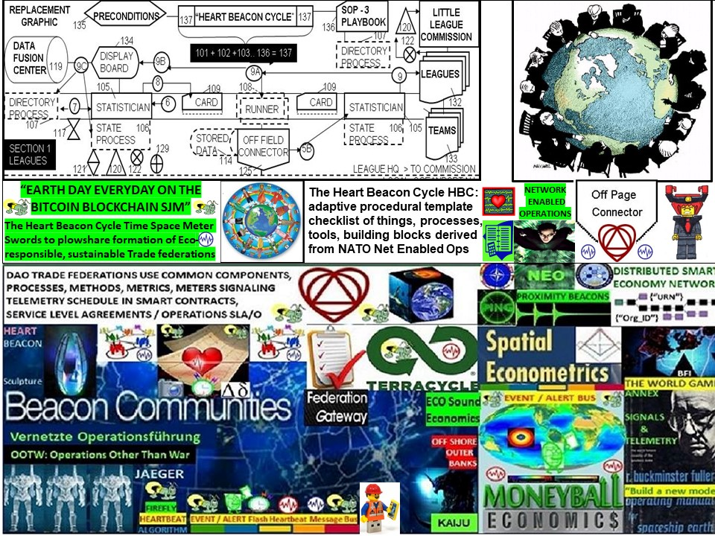

Slide 5
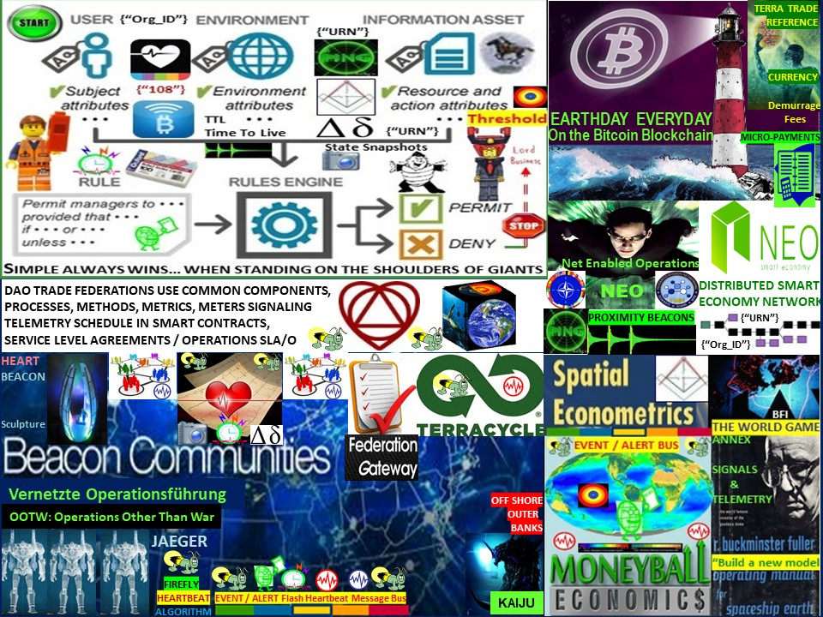

Slide 6
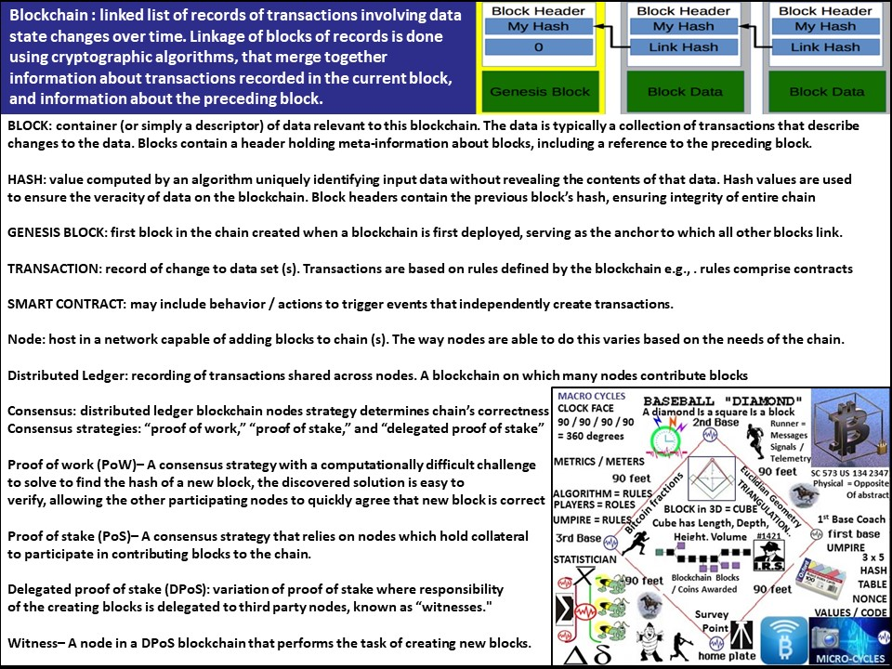

Slide 7
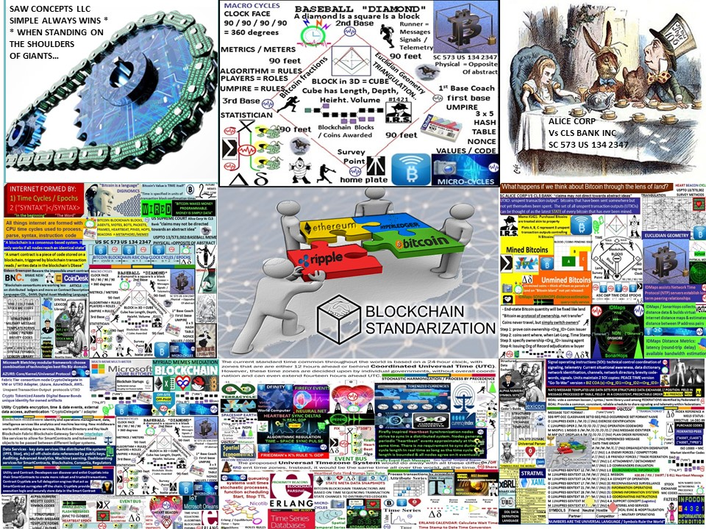

Slide 8


Slide 9
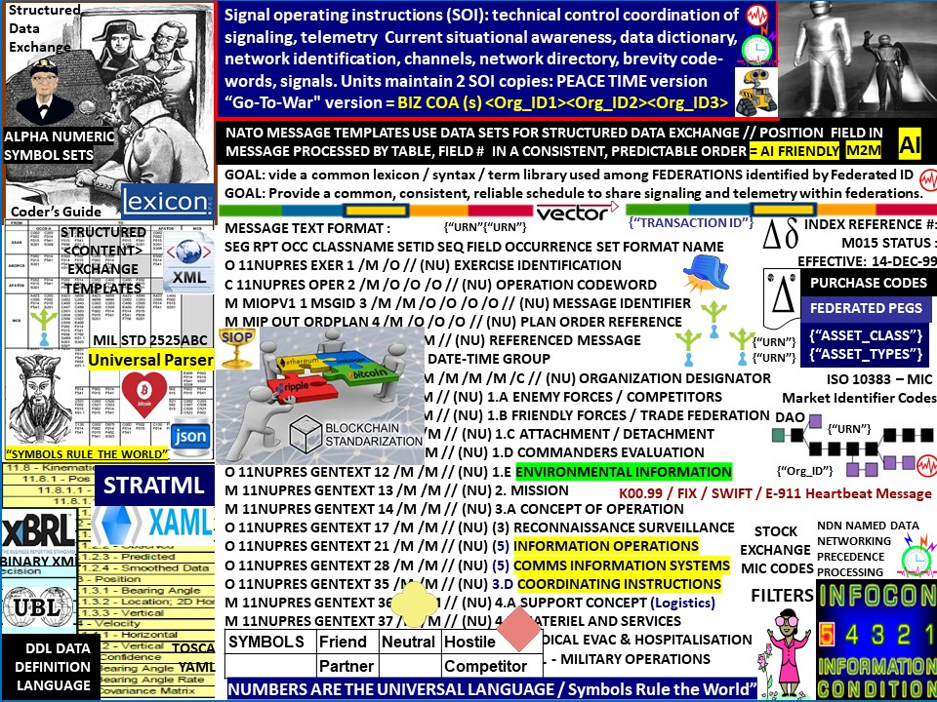
Notes:
Math / numbers = universal language. Think of all the languages used by all the nations of the world. now think of all the programmer, coder's conventions for identifying or tagging different types of data for example </tag> or {"tag"} or indents on a page... use of alpha-numeric codes lend to machine to machine programming -- Internet of Things and reduces ambiguity among humans speaking many, many different languages and dialects. We live in a man-machine world do we not?

Slide 10
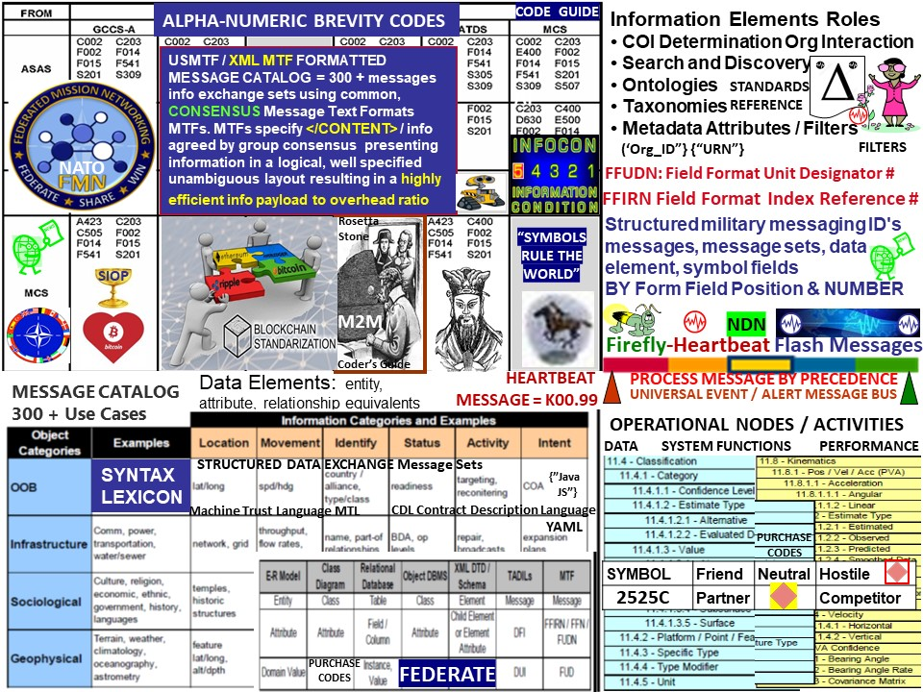
Notes:
Structured military messaging ID's messages, message sets, data element fields BY NUMBERs
The Next Web TNW: a common syntax library and ability to convert <tags> to YAML indents to binary XML to various other Message Text Formats MTF to enable universal signaling / telemetry among a system of systems is ESSENTIAL. Decades of research at the taxpayer's expense into structured messaging will help accelerate the process of organizing syntax into categories and forming syntax from disparate systems into template libraries
One of the DHS's top three goals is "A national common operating picture for critical infrastructure". A congressional directive states "nothing less than network centric homeland security akin to network centric warfare". Interoperability challenge develop a common syntax library / Rosetta Stone among disparate systems to form an integrated, synchronized, situational awareness system of systems. Develop common syntax libraries among that convey network status and configuration data (e.g, router MIBs / multicast group subscriptions) using schemas, data islands that can be parsed / processed among various data encoding approaches such as:
Federal / Military / NATO / International Structured Messaging
Named-Data Networking NDN <Content> Centric Networking (XML tags)
OASIS TOSCA YAML document indent data encoding scheme

Slide 11
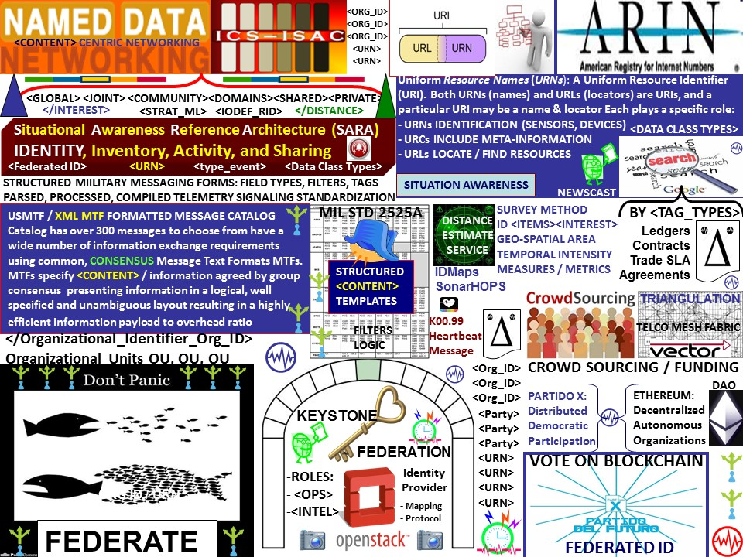
Notes:
FEDERATION: A federation (from Latin: foedus, gen.: foederis, "covenant"), characterized by a union of partially self-governing states or regions under a central (federal) government. In a federation, the self-governing status of the component states, as well as the division of power between them and the central government, are typically constitutionally entrenched and may not be altered by a unilateral decision of either party, the states or the federal political body. In a CLOUD COMPUTING FEDERATION, individual users / organizations retain AUTONOMY.
ORGANIZATIONAL IDENTIFIER <ORG_ID> An organization may establish more than one Org ID, An Organization ID (Org ID) represents a business, nonprofit corporation, or government entity in the ARIN database. The Org ID is defined by a legal name, postal address, and points of contact. IP addresses and AS numbers directly assigned or allocated by ARIN must be associated with an Org ID. Internet Service Providers and other direct allocation holders may also reassign or reallocate IP addresses to an Org ID. https://www.arin.net/resources/request/org.html
Federated Identity Management: federation describes the organization arrangements necessary for interconnection between teams, leagues, and commissions joined to achieve common goals. Federated systems need to interoperate across organizational boundaries and connect processes utilizing different technologies, identity storage, security approaches and programming models. Within a federated system, identities and their associated credentials are still stored, owned and managed separately. Each individual member of the federation continues to manage its own identities, but is focused on sharing and accepting identities and credentials of the group. Within a federated system, an organization needs a standardized and repeatable way of describing services it makes available to teams in leagues and policies by which it runs its operations. Operations are performed as part of group’s activities. Resources available to the group include the health or availability of individuals forming groups where monitoring is performed to ascertain if groups are mission capable or not in context with available resources and whether the group’s location is within a pre-defined geo-spatial range of a given activity or event. The definition of equitable arbitrage is defined by the entities entering the agreement as clauses. Federated identities within a group retain their autonomy and ability to act on their own behalf
Slide #23: virtual organizations -- using ORG_ID (s), an organization may have >1 for contingency planning:http://www.slideshare.net/kvjacksn/ncoic-gcc-owsows-10-presentation-10-7-2013#! Network Centric Operations Interoperability Consortium NCOIC Cloud Briefing to Open Geospatial Consortium OGC
http://lnkd.in/d9NKf7G Crowdclan: New way businesses can leverage the technology – internal employee crowdfunding // CROWDS organized into virtual FEDERATIONS using survey methods, triangulation techniques to identify samples of potentially interested individuals interested in joining adhoc, agile groups in near real time trade arbitrage e.g., Real Time Bidding / Auctions / Voting etc.

Slide 12
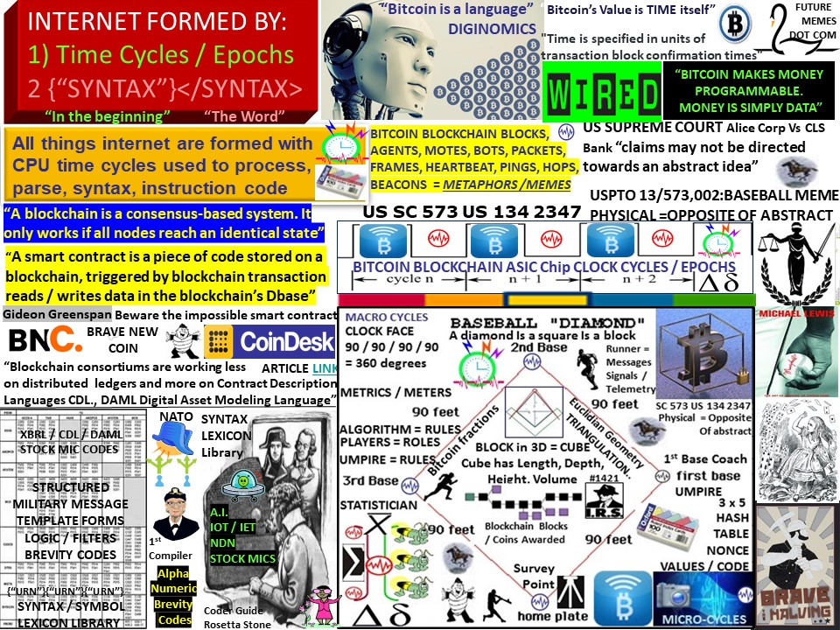
Notes:
Internet ground truth - #Bitcoin blockchain blocks, agents, motes, bots, web crawlers, heartbeat, beacon are all metaphors for intervals, time cycles available to process / not process SYNTAX.
In other words, the internet is time cycles available to process instructions, commands etc. It follows that the key to achieving consistency, interoperability across seemingly diverse technologies and establish common ground among groups using various internet technologies is to focus on the two main common building blocks -- time and syntax. If everyone using the Internet of Things set sensor reporting cycles to the maximum rate, the network may saturate. Too frequent reports are distracting. Too slow reports are not relevant. Operational discipline of time cycles is an imperative and establishment of a common syntax lexicon repository is needed.
Displaying "The Grail" -- Single Integrated Operational Picture SIOP after the fact is problematic -- especially if many different data management techniques are in use. Cycles in time -- the "heartbeat" as opposed to a data ping that has no conventions for data other than the ping itself is the internet's ultimate common tool / mechanism.

Slide 13
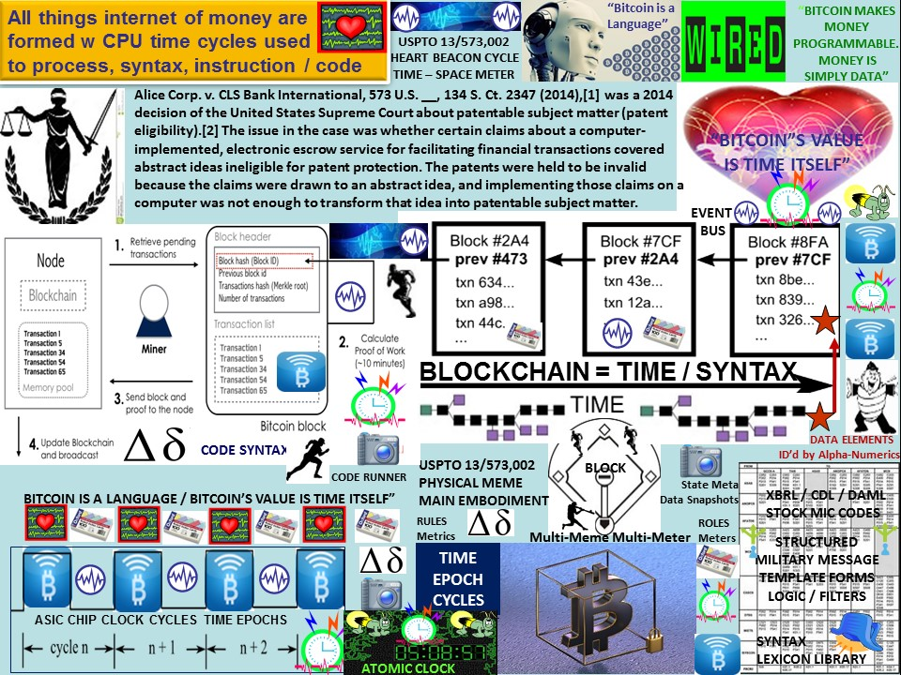

Slide 14
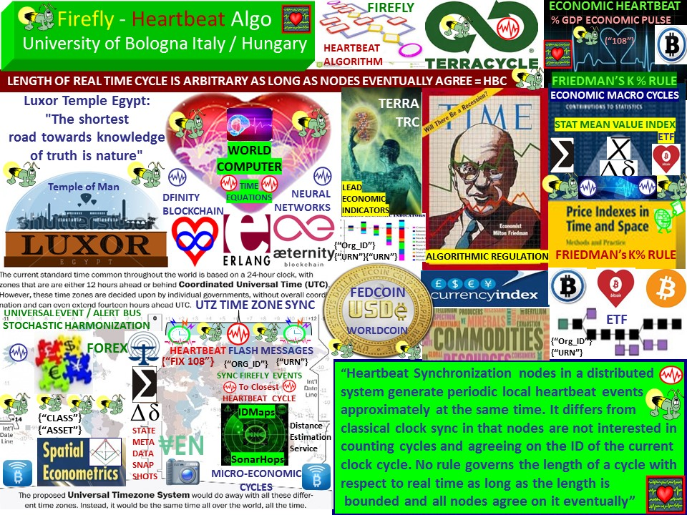

Slide 15
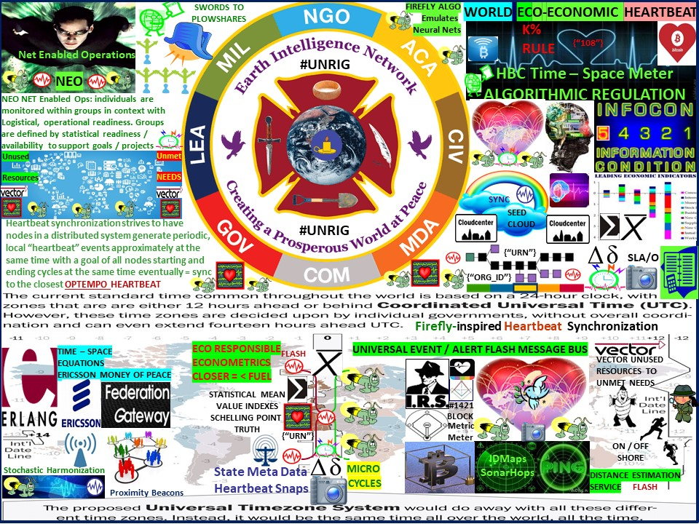

Slide 16
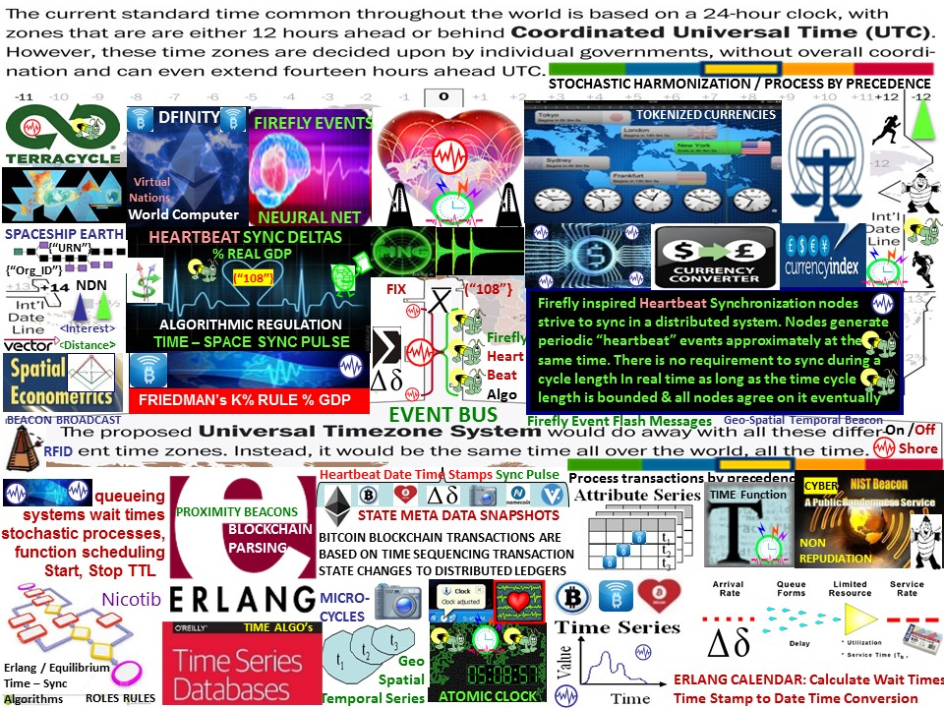
Notes:
Universal Time Zone Proposal UTZ synchronization -- which algorithm would support a universal event bus / mimic neural net neuron firings?

Slide 17
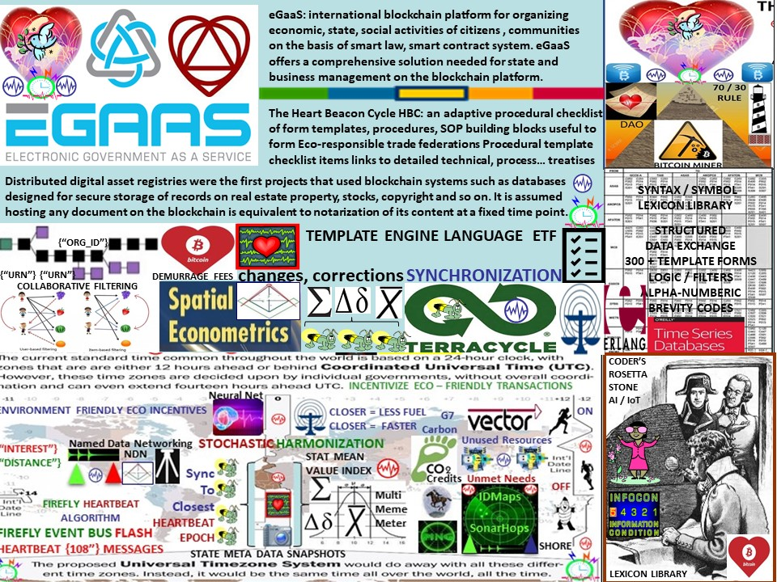

Slide 18
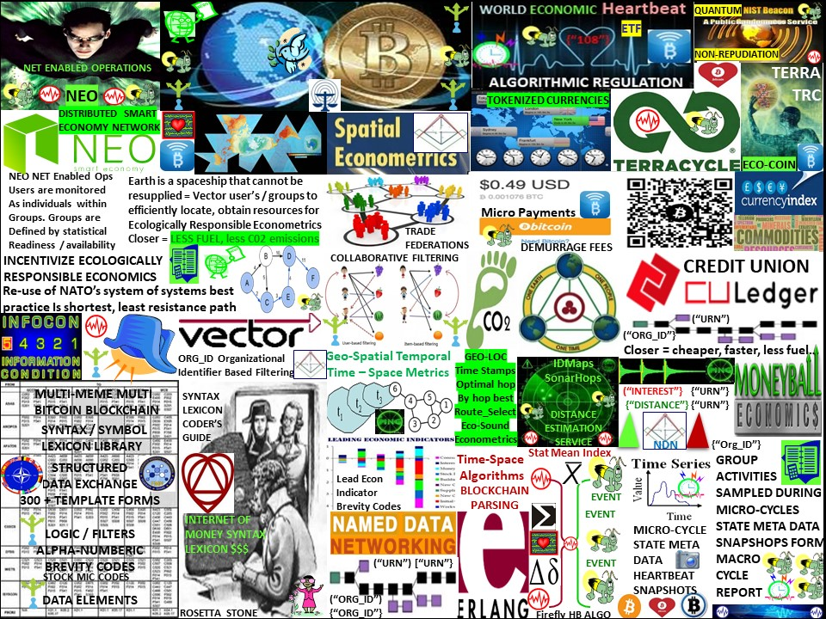
Notes:
The Heart Beacon Cycle (HBC): Swords to plowshare re-use of tax subsidized best practice. Military’s do one thing very well: individuals join groups (units) synchronized in time-space to accomplish common goals. Adaptative use case: geo-spatial, temporal econometrics, vectors to reduce CO2 carbon footprint due to inefficient transport, resource, logistic vectors. The HBC applies a novel use of an algorithm based on nature and NATO best system of systems engineering practice. It includes geo-spatial, temporal metrics, measures, and Incentives for ecologically sound geo-spatial, temporal econometrics. It is an adaptive procedural template checklist of things, processes, tools, building blocks useful to form, maintain Eco-responsible trade federations. Each item in the procedural template checklist links to a detailed treatise. We can synchronize ourselves and our cities in time - space for a common purpose: ecologically sound econometrics i.e., through use of a Signals and Telemetry annex for Buckminster Fuller’s Operations Manual for Spaceship Earth. The HBC involves a heartbeat flash message universal event, alert message bus. It is based on NATO's best practice, 300 + structured data exchange templates, micro-macro (economic) situational awareness sync delta data exchange schedule. The Heart Beacon cycle includes a universal metrics measurements physical meme (see Supreme Court Alice Corp Vs CLS Bank) for use among myriad Bitcoin Blockchain internet of money blocktime arbitrage memes to support standardization of a one world economic system

Slide 19
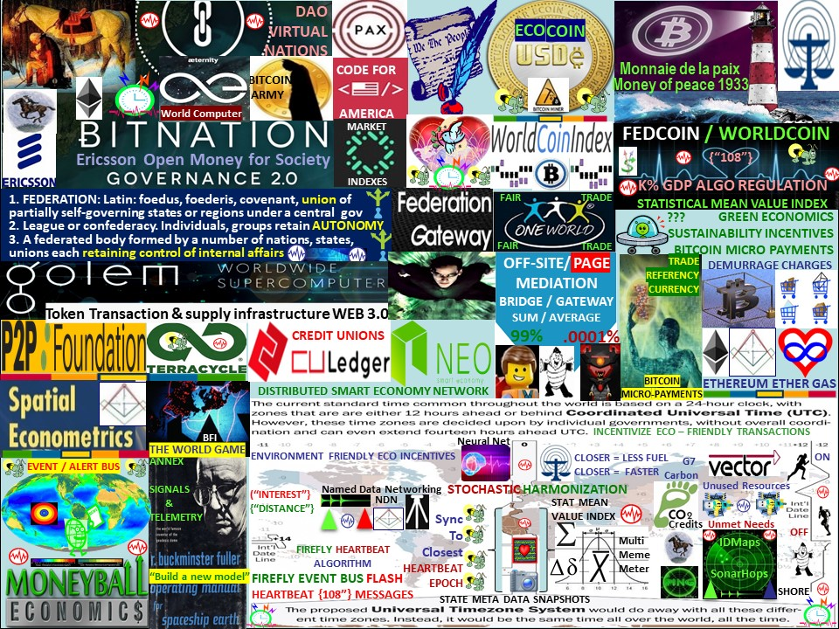

Slide 20
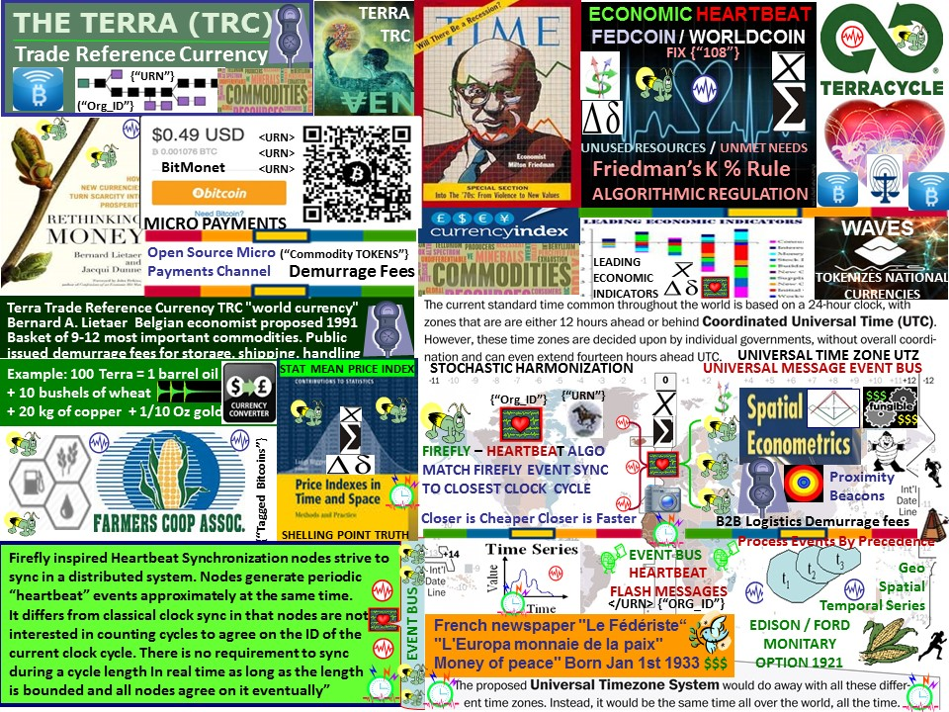
Notes:
TERRA Trade Reference Currency / RIPPLE monetary protocol. The Trade Reference Currency (TRC) TM is a new currency privately issued by the TRC Alliance, with a built-in circulation incentive that could play a significant role in getting the world out of recession. Its unit of account is the Terra. It would systematically stabilize the effects on the business cycle and re-align financial interests with long-term sustainability. Terra: demurrage-charged currency acts like parking fee, incurring cost over time to holder estimated at 3.5%-4% per annum corresponding to costs incurred for storing physical commodities in the Terra basket. Monetary Instability: Over $1.3 trillion is traded per day in foreign exchange markets, a figure that is 100-fold the trading volume of all of the world’s stock exchanges combined. . Nearly 96% of these transactions are purely speculative; they do not relate to the “real” economy; they do not reflect global movements or exchanges of actual goods and services. Terra commodities should be described by <Uniform_Resource_Name> <URN> that should be tracked during micro-cycles and threshold differences updated in decision support applications during macro-cycles corresponding to micro-economic / macro-economic reporting cycles. Differences in value should be processed by mediation, federation gateways then shared across zones / domains. http://www.terratrc.org/PDF/Terra_WhitePaper_2.27.04.pdf .
The TERRA Trade Reference Currency: complementary, privately issued, demurrage-charged, backed by inflation-resistant, standardized basket of the dozen most important commodities, services and operates in parallel with national currencies. Terra The Trade Reference Currency, TRC "world currency". Proposed by Belgian economist and expert on monetary systems Bernard A. Lietaer in 2001, based on a similar proposal from the 1930s. The currency is meant to be based on a basket of the 9-12 most important commodities (according to their importance in world wide trade). Terra = reference unit defined as standardized basket of key internationally traded commodities & services. Macro to micro reporting is key to establishing a value index for the Internet of Everything IeT through use of reliable time stamping by <Org_ID>, <URN>

Slide 21
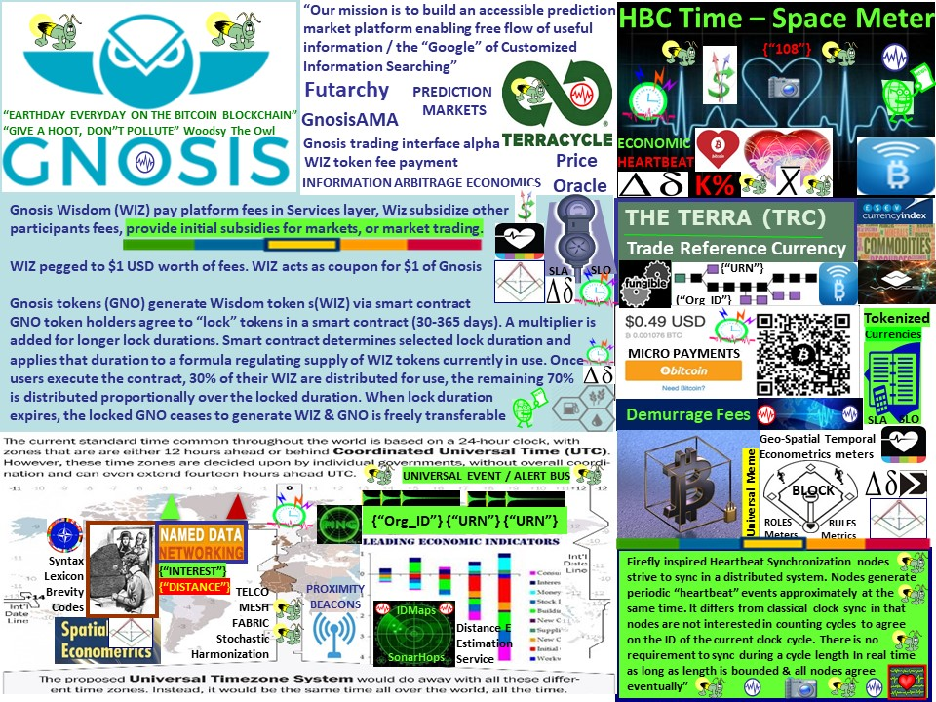

Slide 22
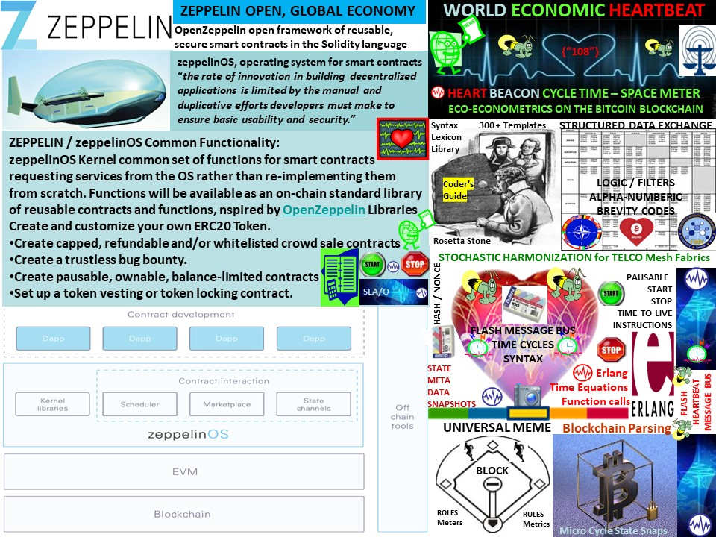

Slide 23
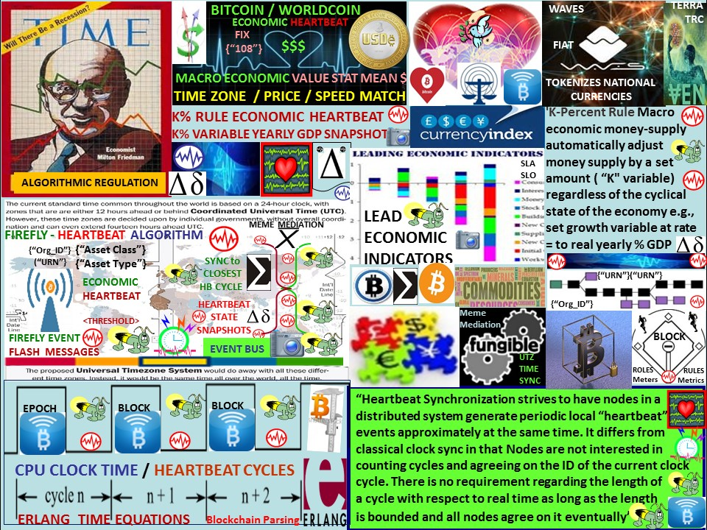
Notes:
‪#‎Bitcoin‬ FEDCOIN / WORLDCOIN: index of currencies, commodities, stocks, .com domain values extending Thomas Edison's 1921 vision: #Bitcoin currency / commodity price index: firefly heartbeat algorithm, IRS memo 1421 Bitcoin is property memo metrics, survey methods Statistical mean commodity / currency price index derived from firefly algorithm / closest heartbeat. BITCOIN's variations on the theme, fork splits, different coin counts, proof of work Vs proof of stake, coins pegged to precious metals, other coins pegged to an currency index of 22 +/1 other currencies (VEN) and a future coin pegged to a commodity basket index poses a challenge to Bitcoin's fungibility or 1 to 1 conversion among coins. Keep in mind that all things internet are formed by time cycles used / not used to process syntax as instructions. See SAW Concept's slide using a novel firefly inspired algorithm combined with the closest heartbeat cycle. See also SAW Concept's LLC's internet survey techniques -- triangulation etc. in context with the IRS interpretation of Bitcoin as property and a land use meme.
REFERENCE: BOOK: Price Indexes in Time and Space: LINK http://www.springer.com/us/book/9783790821390

Slide 24
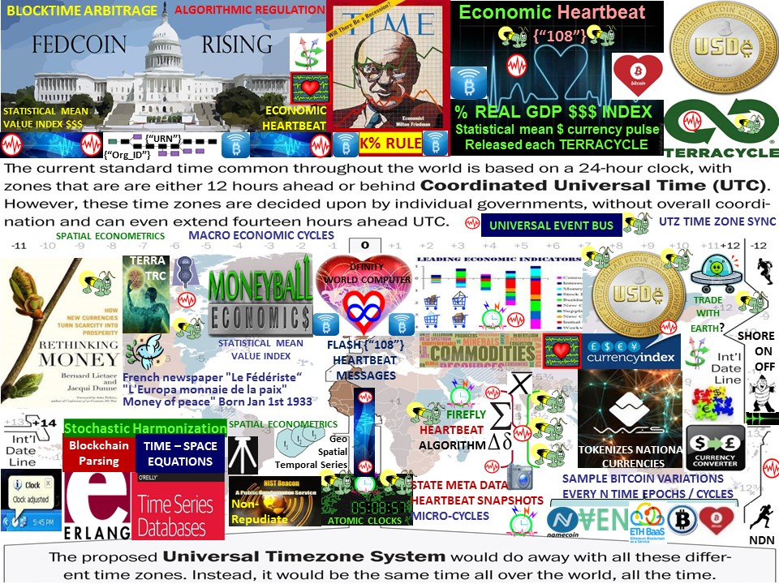
Notes:
Monetizing schemes = value sampling across Universal Time Zone UTZ system - stochastically harmonized value samples http://sawconcepts.com/index/id9.html

Slide 25
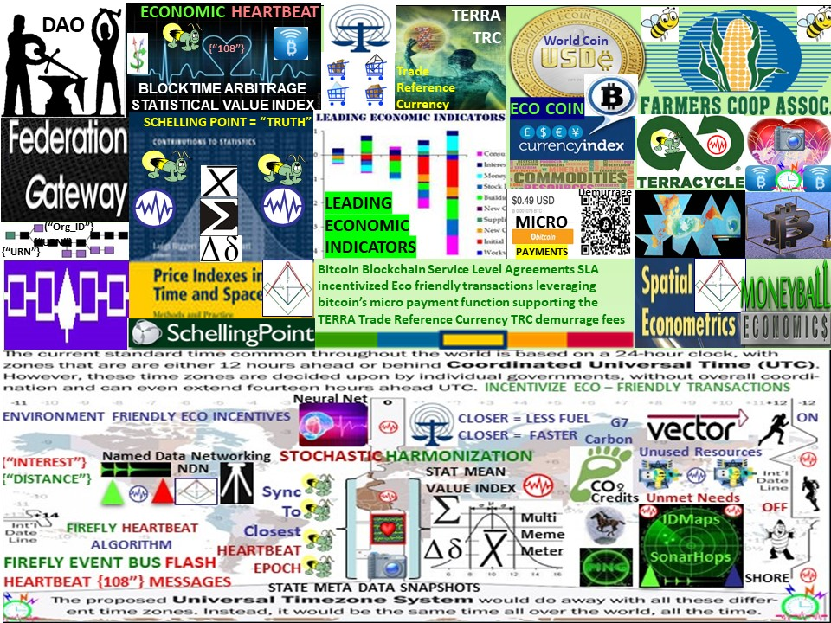

Slide 26
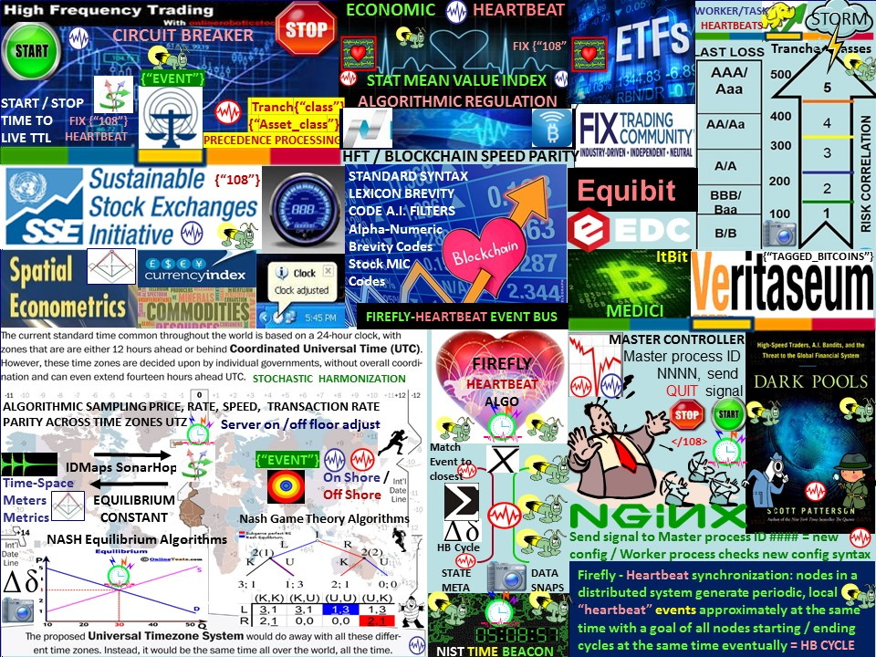
Notes:
STAAS: Space Time As A Service. A use case of the firefly inspired heartbeat synchronization algorithm in stock and currency exchanges is algorithmic regulation cited by economist Milton Friedman. For example, improving temporal trade parity between Bitcoin Blockchain & conventional stock exchanges by using the firefly-heartbeat algorithm to take trade speed samples among trade populations across time zones to determine an optimal trade speed / frequency as a statistical mean. Trading velocity far exceeds Bitcoin's current transaction rates estimated to be between 3 - 7 transactions per second and far exceed non-HFT trading capacity. A method is needed to establish temporal trade parity and account for on floor / off floor trading disparity -- enter STAAS Space - Time As A Service using a novel stochastic harmonization algorithm based on the mating behavior of certain species of fireflies that strive to sync during mating activity matched to the closest Operational Tempo OPTEMPO heartbeat cycle.
Wall Street Stock Exchanges must solve the problem where High Frequency Trade transactions far exceed the ability of a regulatory, monitoring 3rd party's (DCCC) ability to record, verify and validate transactions -- a computational job that the Bitcoin Blockchain is being used to solve. Project Medici intends to create a blockchain based securities exchange. “Medici,” the project aims to democratize Wall Street in much the same way bitcoin seeks to democratize currency and payments. By operating separate from traditional stock exchanges and the big corporate banks, it could eliminate certain loopholes in the system and reduce the costs associated with issuing and juggling stock.
All sophisticated algorithms, bots, mots, scripts, agents.. make use of the heartbeat -- opportunities, intervals, windows in time. High frequency flash trade algorithms are sophisticated and distributed -- however, all algorithms report to a single master controller. The heartbeat = start bit / stop bit, Time To Live = algorithm on / algorithm off / algorithm duration. Heartbeat </108> messages and the heartbeat time cycle can be used to limit trade sessions by trading session or trade time cycle e.g., one trade per cycle and / or n trades per session. Geo-spatial temporal techiques like IDMaps and SonarHop and the firefly heartbeat stochastic harmonization method can be used to account for trades distributed across time zones and trading on the stock exchange floor and off where the length of the fiber optic cable makes a difference in High Frequency Trade volume. Time cycles match Bitcoin blockchain transaction rates currently estimated to be 3 – 7 per second with High Frequency Flash trade rates. Project Lighning's sync delta approach -- sending only the changes to ledgers from one (heartbeat) time cycle to the next instead of refreshing the entire ledger is one solution to address trade spped parity.

Slide 27
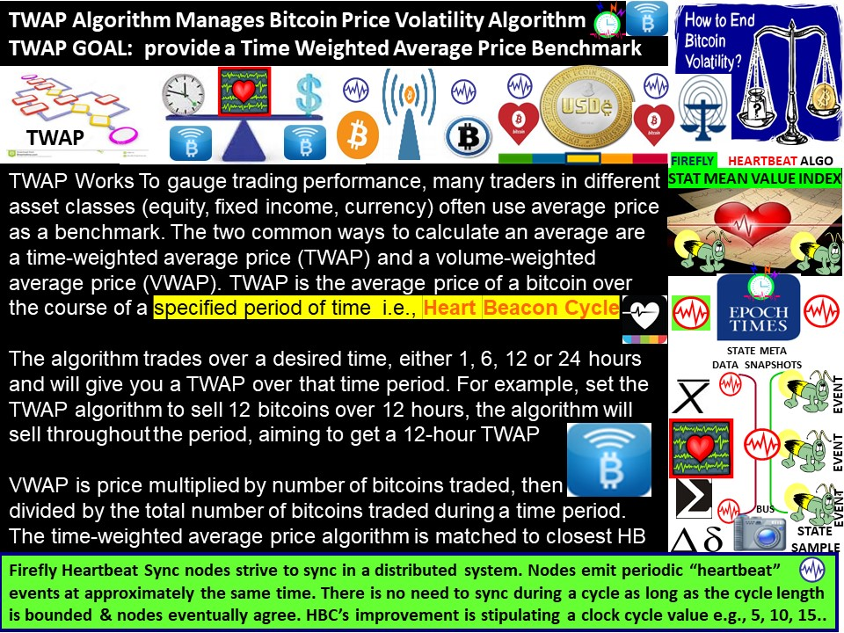

Slide 28
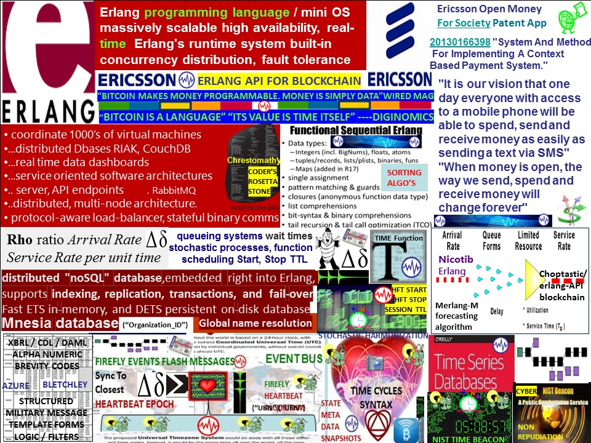

Slide 29
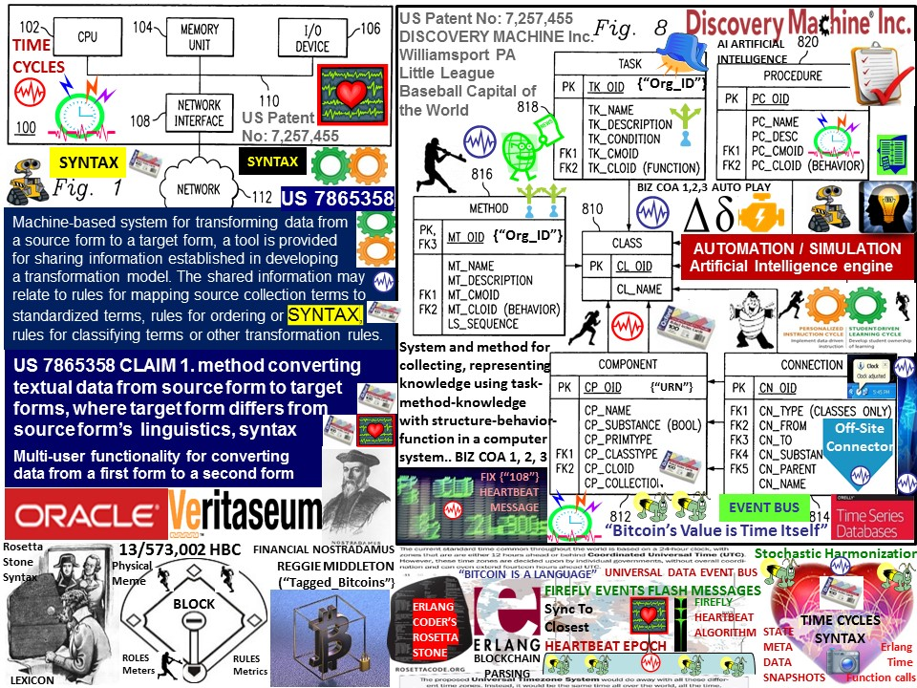

Slide 30
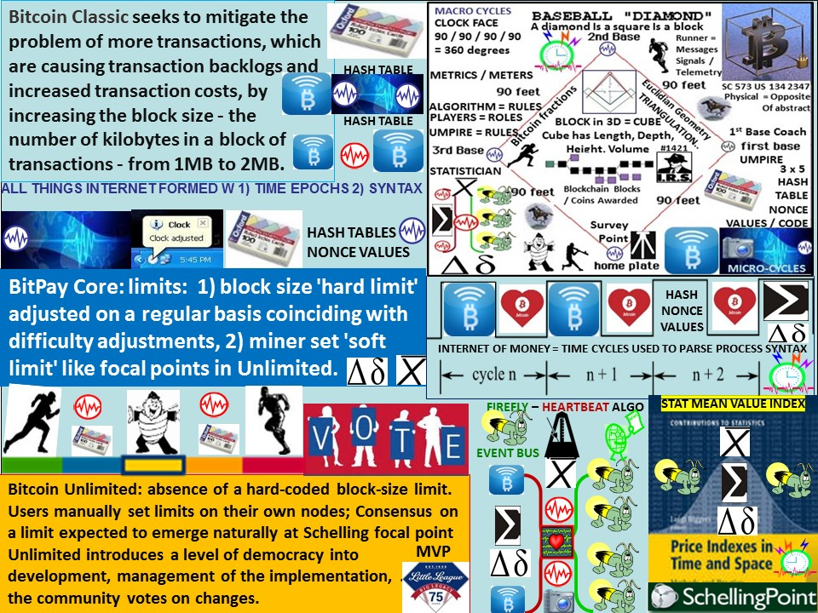
Notes:
#Bitcoin classic, core, unlimited + US SCt 573 Alice Corp V CLS Bank = no abstract ideas =physical = opposite of abstract = USPTO 13/573,002 see http://sawconcepts.com/id66.html What is your SCt compliant meme?

Slide 31
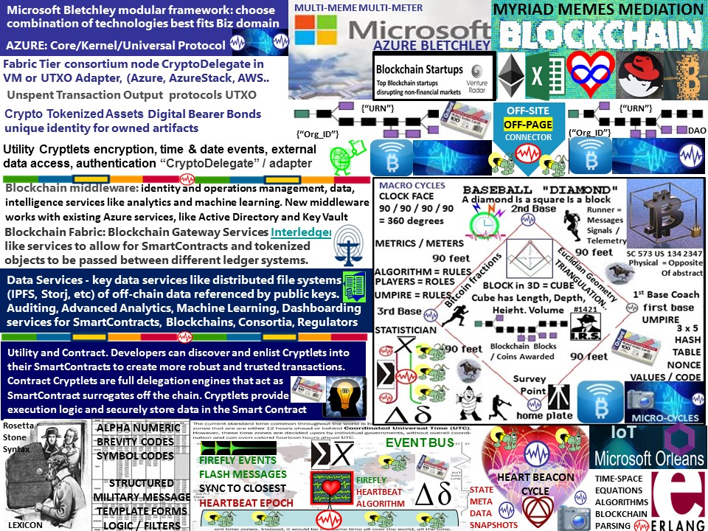

Slide 32
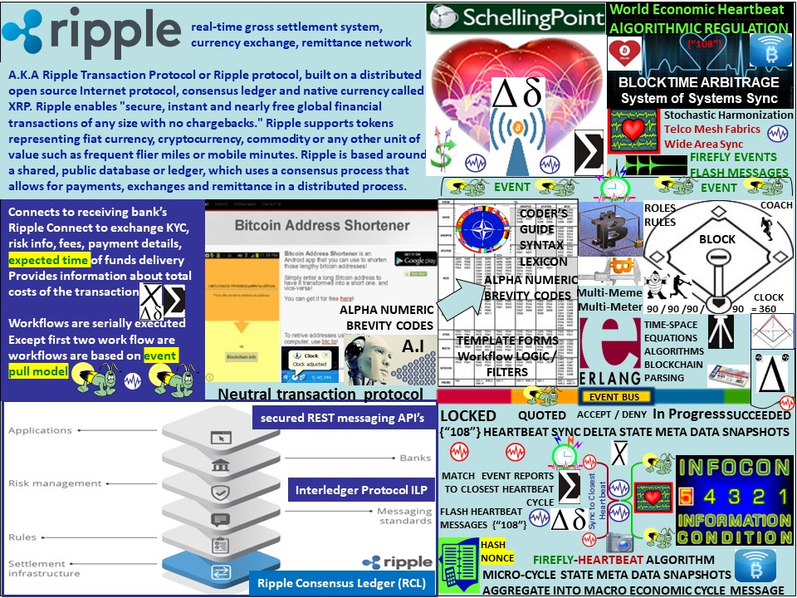

Slide 33
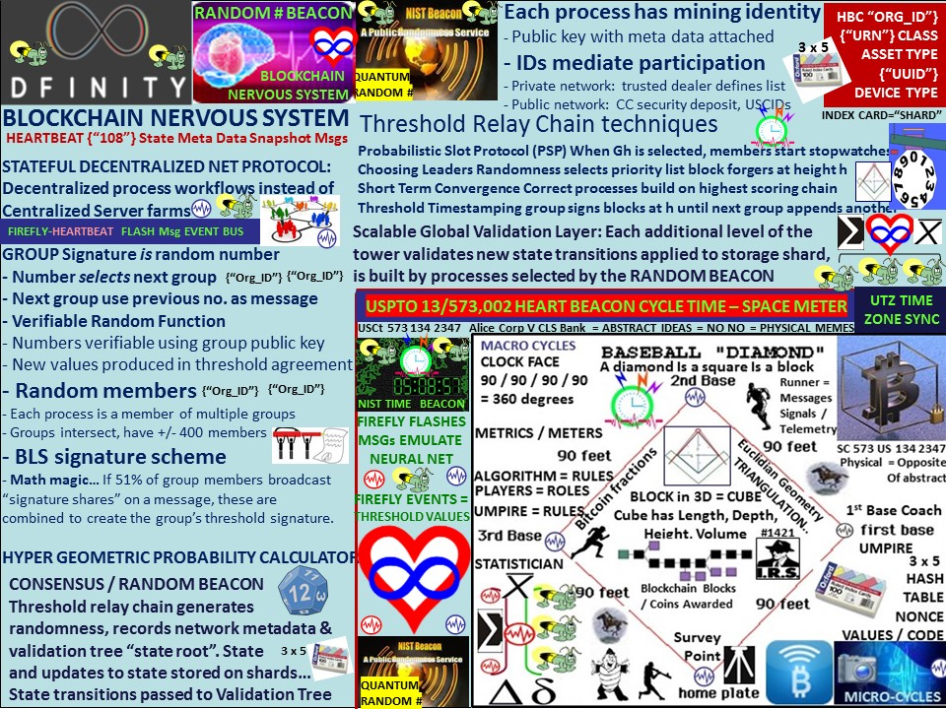

Slide 34
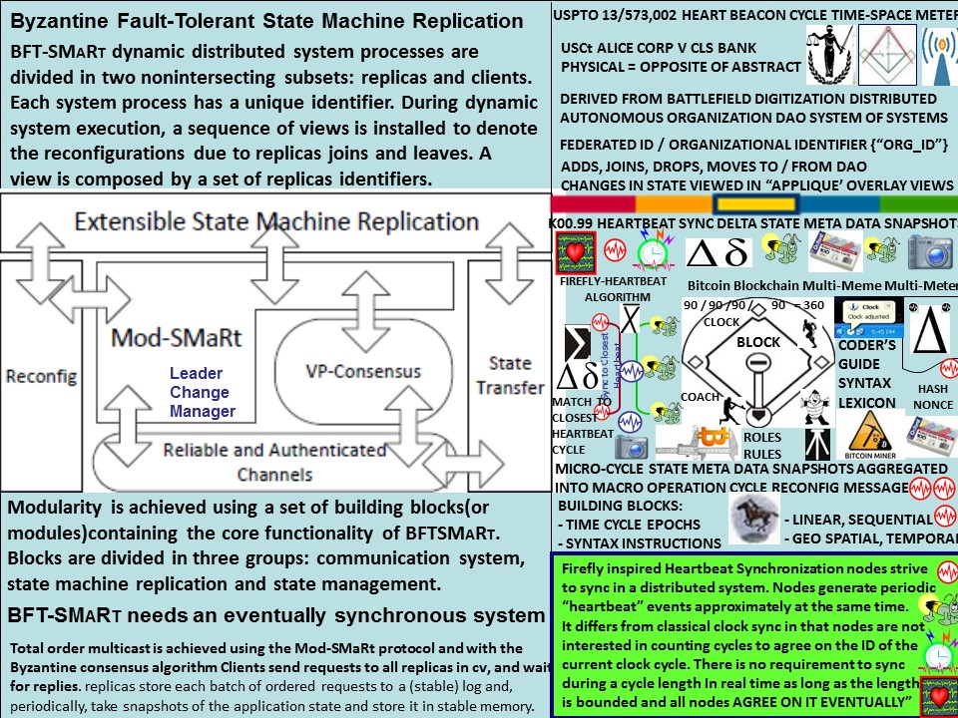

Slide 35
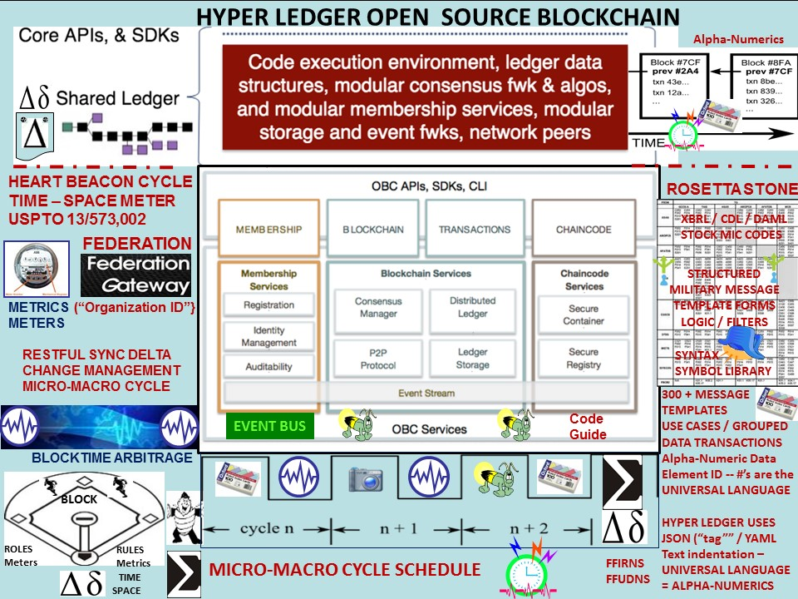

Slide 36
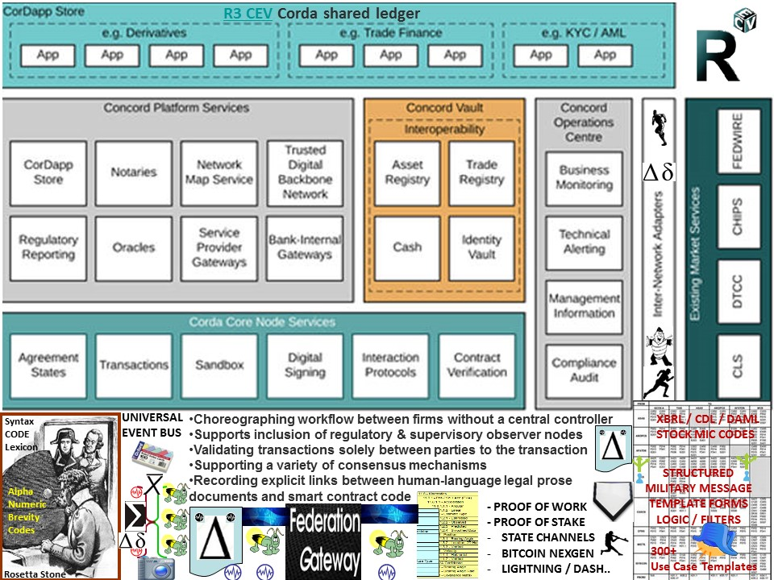

Slide 37
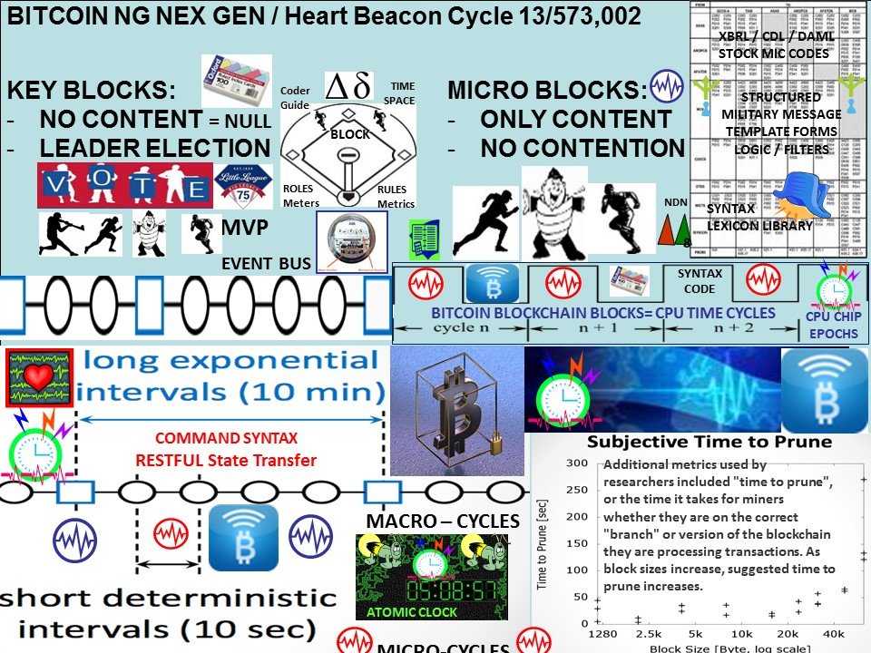

Slide 38
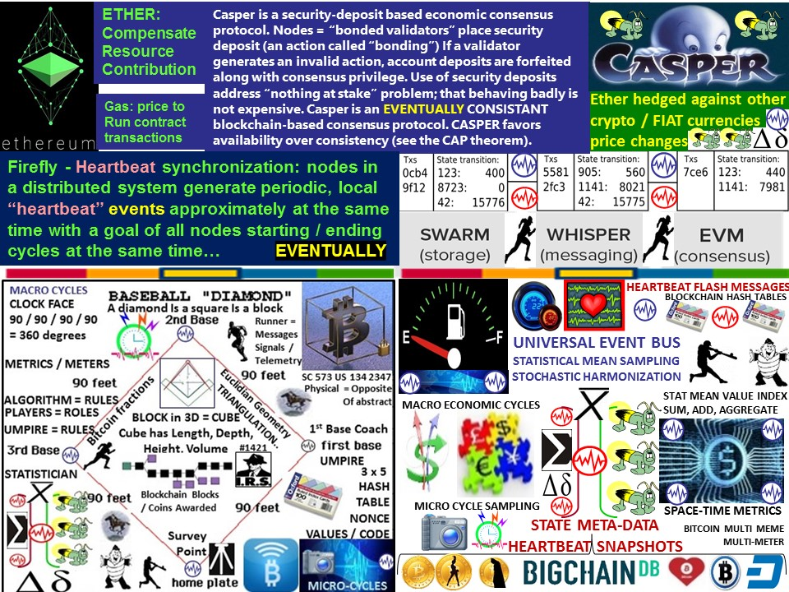

Slide 39
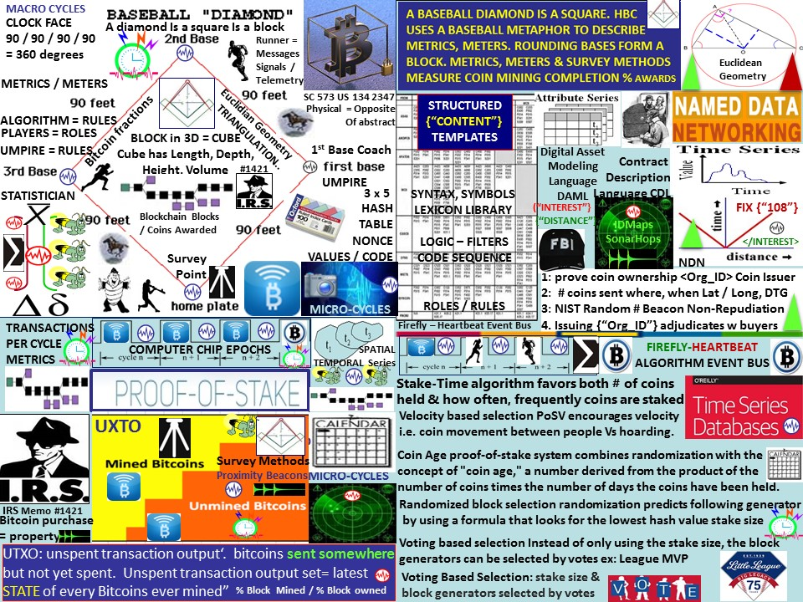
Notes:
Quote from @DCCCertified @InsideBitcoins "Build mental models that help people wrap their heads around Bitcoin w/o having to understand it"
Bitcoin blockchain proof of work, proof of stake and patent application #13,573,002 Heart Beacon Cycle time / space meter applique overlay, survey methods metaphor comparison.
A baseball diamond = block. A block is formed using age (time) or vectors time / direction / velocity or voting (tournament league board) http://bit.ly/1CqYyYx
The Heart Beacon Cycle is described using a baseball league tournament. As such, it's immune to recent USPTO, Supreme Court ruling limiting software process patents. See SAW Concept's slide using a novel firefly inspired algorithm combined with the closest heartbeat cycle. See also SAW Concept's LLC's internet survey techniques -- triangulation etc. in context with the IRS interpretation of Bitcoin as property and a land use meme.Patent application # 13,573,002 The Heart Beacon Cycle Time - Space Meter: LINK

Slide 40
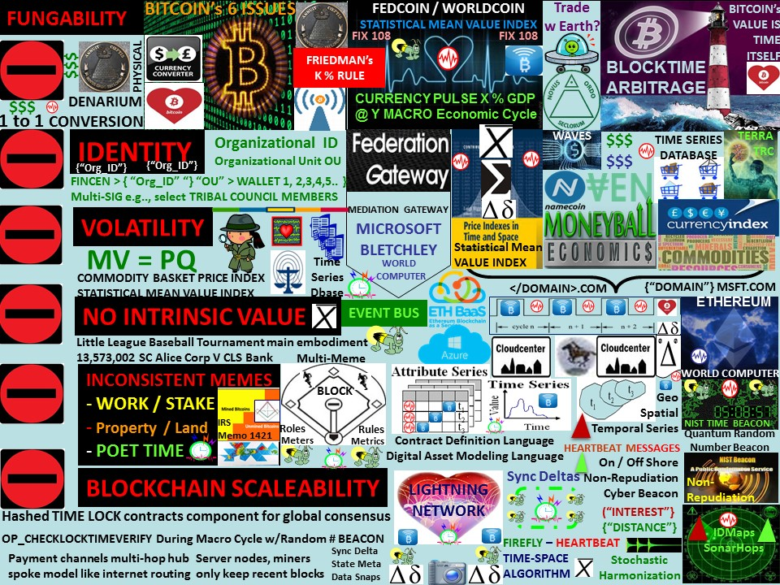
Notes:
The Bitcoin community has six issues: Volatility, Inconsistent Memes for taxation, fungibility, Identity, lack of intrinsic value and block chain scalability. The Heart Beacon Cycle addresses all six issues systemically. Trade Federations involve widely dispersed members using divergent technologies. What must not be divergent is a valuation of goods, (time) based services, commodities and currencies that require consistent metrics, meters and methods to determine geo-spatial temporal time increments such as duration intensity, frequency and methods to establish stochastic harmonization of value samples taken during micro economic cycles for aggregation into macro - economic reports across time zones -- STAAS - space / time as a service with a mediation gateway to determine change or sync deltas that are beacon broadcasted among a system of system's and sub-systems.
Article: Could the Bitcoin Lightning Network Solve Block chain Scalability? LINK: "hashed time-lock contracts between users, in the block chain, if only two participants care about a transaction, it’s not necessary for all other nodes in the bitcoin network to know about that transaction. It is instead preferable to only have the bare minimum of information on the block chain. It is desirable for two individuals to net out their relationship at a later date, rather than detailing every transaction on the block chain. This can be achieved by using time locks as a component to global consensus. As a result, Bitcoin can scale to billions of transactions per day with the computational power available today on a modern desktop computer. Transaction between users occurs during a micro-cycle, then reconciled at a pre-arranged macro-cycle, with a NIST Cyber Beacon random # time stamp for non-repudiation given reconciliation will occur at a later data in time. Link: http://coindesk.com/could-the-bitcoin-lightning-network-solve-blockchain-scalability/
IDENTITY: Organizational unit from Wikipedia, In computing, an organizational unit (OU) provides a way of classifying objects located in directories, or names in a digital certificate hierarchy, typically used either to differentiate between objects with the same name (John Doe in OU "marketing" versus John Doe in OU "customer service"), or to parcel out authority to create and manage objects (for example: to give rights for user-creation to local technicians instead of having to manage all accounts from a single central group). Organizational units most commonly appear in X.500 directories, X.509 certificates, Lightweight Directory Access Protocol (LDAP) directories, active directory (AD), and Lotus Notes directories and certificate trees, but they may feature in almost any modern directory or digital certificate container grouping system. In most systems, organizational units appear within a top-level organization grouping or organization certificate, called a domain. In many systems one OU can also exist within another OU. When OUs are nested, as one OU contains another OU, this creates a relationship where the contained OU is called the child and the container is called the parent. Thus, OUs are used to create a hierarchy of containers within a domain. Only OUs within the same domain can have relationships. OUs of the same name in different domains are independent.
Thomas Edison’s Quixotic Plan for a New Monetary Policy article: During the sharp recession of 1921- 1922, Thomas Edison turned from making innovative consumer products to reinventing the U.S. monetary system. Edison searched for new ways to stabilize the dollar, the value of which had fluctuated widely during World War I and its aftermath. His goal was to “cast the variable out of money.” Distrusting bankers -- the “money brokers,” he called them -- and a monetary policy based solely on gold, Edison called for a system that used a variety of other commodities as backing for the nation’s paper money supply.
Inconsistent memes raises 2 issues: regulatory i.e., taxation given the USA's Internal Revenue Service's stance of Bitcoin as property -- see land use meme, and fungibility among coin types - need consistent metrics and meters to establish a statistical mean value for a FEDCOIN for example. Fungibility is the property of a good or a commodity whose individual units are capable of mutual substitution. That is, it is the property of essences or goods which are "capable of being substituted in place of one another."[1] For example, since one ounce of gold is equivalent to any other ounce of gold, gold is fungible. Other fungible commodities include sweet crude oil, company shares, bonds, precious metals, and currencies. Fungibility refers only to the equivalence of each unit of a commodity with other units of the same commodity. Fungibility does not relate to the exchange of one commodity for another different commodity.
Inconsistent memes: Bitcoin Valuated using land meme. IDMaps and SonarHops triangulation will be useful in surveying the Bitcoin landscape in land as a metaphor for value paradigm. In the end-state the quantity of bitcoin will be fixed, just like land. Bitcoin is not perfectly fungible, neither is land. Bitcoins are not ‘consumed’ through use – just transferred. This is similar to land and dissimilar to many commodities, that are consumed, degraded) through use.
"Bitcoin is not a protocol of transfer, but a protocol of ownership. Coins never travel, but simply switch owners”. IDMaps / SonarHops help construct the maps of land that visually show how much of the Bitcoin has been mined / issued. Battlefield digitization data is often shown on maps as appliqué overlays in military speak and involves cyclic state meta-data refresh from micro to macro (economic, ecological harvesting etc.) cycles.
Stellar is public infrastructure for money. Supported by a non-profit, Stellar brings the world together by increasing interoperability between diverse financial systems and currencies. The new platform is a decentralized gateway for digital currency to fiat currency transfers,. Like Ripple and bitcoin, Stellar will act as a public transaction authenticator and feature its own in-house digital currency called ‘stellar’. Stellar will act as a bridge between fiat and digital currencies – a key requirement if the latter are to be adopted by mainstream users. Stellar details. Stellar acts as a transaction gateway between fiat and digital currencies. The new platform is a decentralized gateway for digital currency to fiat currency transfers,

Slide 41
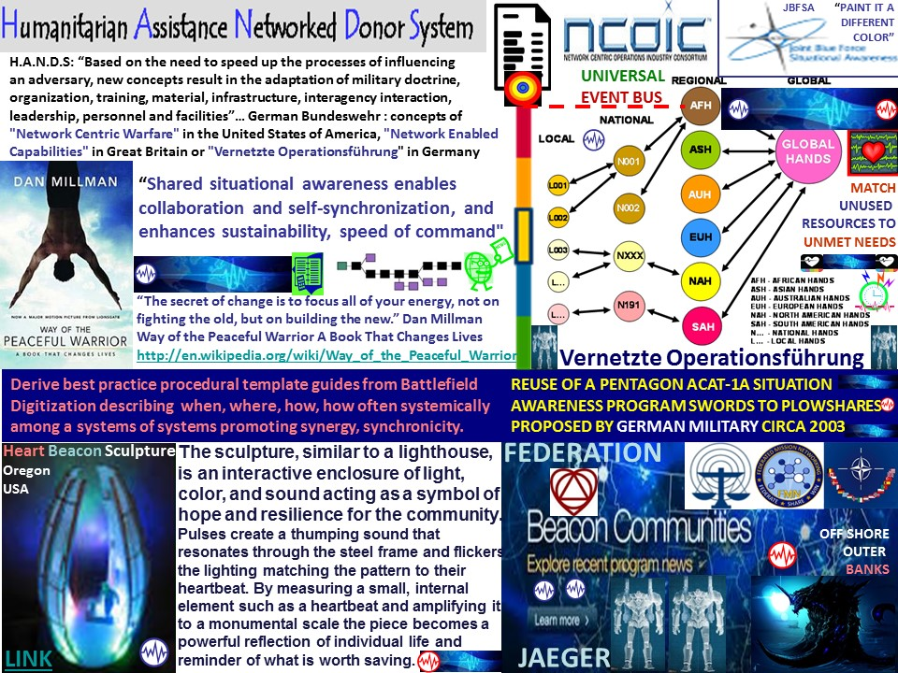
Notes:
The INTERNET fundamentally relies on TCP/IP Unicast and Multicast. Blue Force Tracker, the United States Army's "Greatest Invention" (co-developed by the US Marine Corps later in time) relies on a form of multicast IP, Global Positioning System GPS and gathering of unit status prior to data fusion center insertion. Unit status is derived from sampling state meta data. This state meta data is collected during internet "heartbeat intervals" by heretofore unused intervals in time set aside by the original developers of the Internet (Stanford University etc., ) for an unknown future use. The reserved intervals in time were used by US Army network engineers to gather state changes describing the status of individuals formed as units / groups -- location, unit designation or <Org_ID>, resource status by <URN> Uniform Resource Name that are used to determine mission readiness. Intervals or units in time are referred to metaphorically as "heartbeat, heartbeats" or "heartbeat-beacons". There are no "motes", "bots", "agents" or "heartbeats" -- only intervals, cycles, opportunities in time to do or not do (computational) tasks. Workflow is instructions to cause action / non-action -- instructions carried to platforms, nodes, devices.. by multi-cast, uni-cast broadcasts -- basically speaking. In other words, achieving situational awareness, situation understanding among many distributed organizations and locations is not as complicated as it sounds. Keep in mind that the Army and Marine Corps have relied on situational awareness across a wide area, distributed network for decades -- since the late 1990's. If a common procedure and common building blocks used in an iterative, cyclic process has worked for several decades in harsh conditions with sleep deprived, youthful soldiers, one would think that this technique would be replicable in commercial domains.

Slide 42
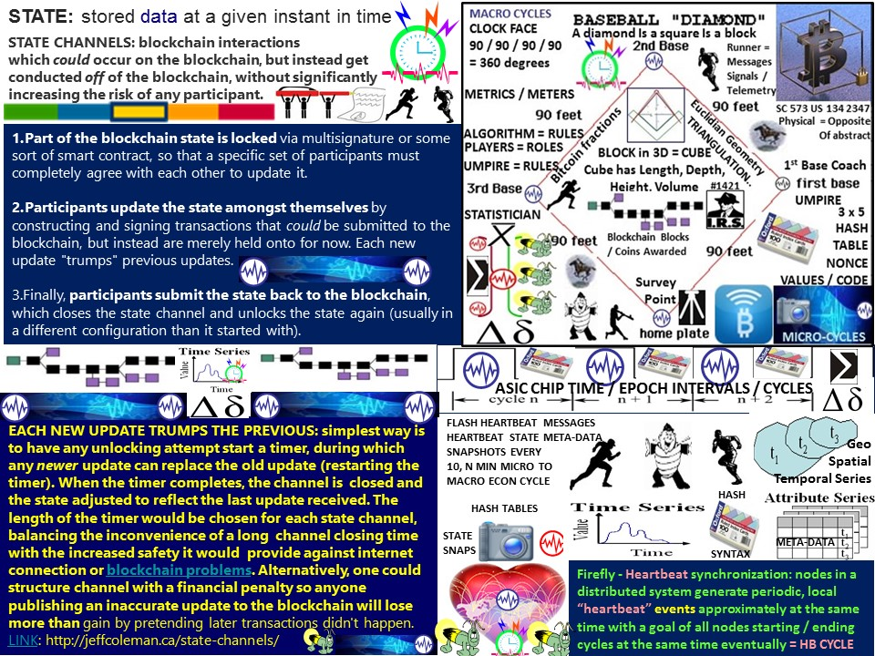

Slide 43
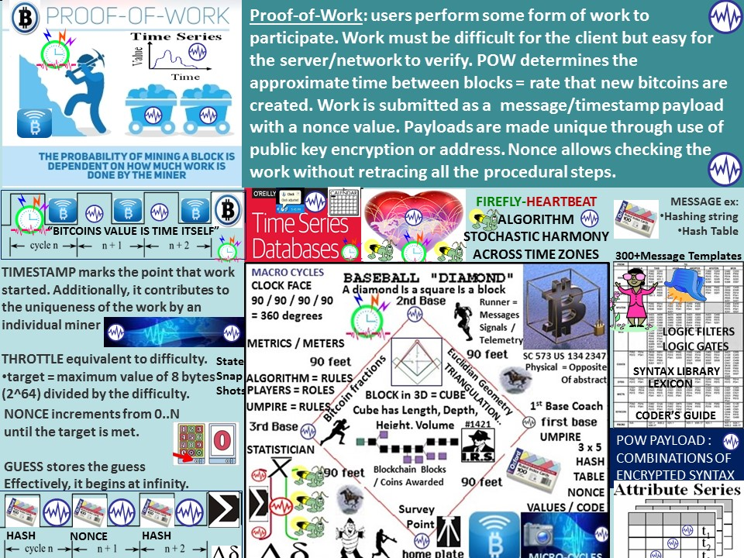

Slide 45
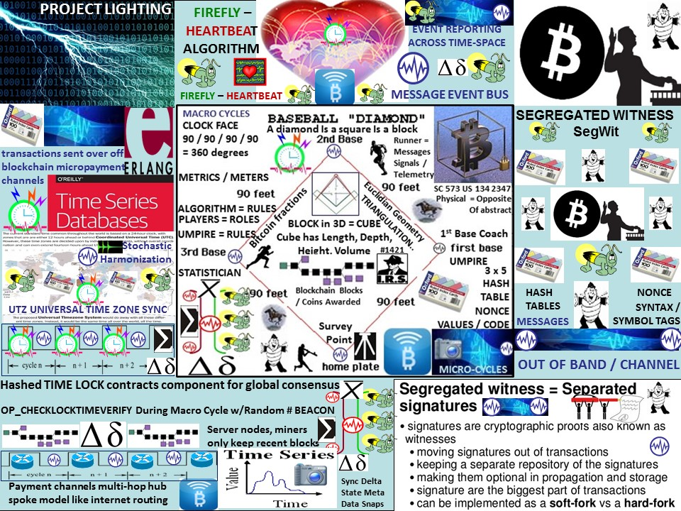

Slide 46
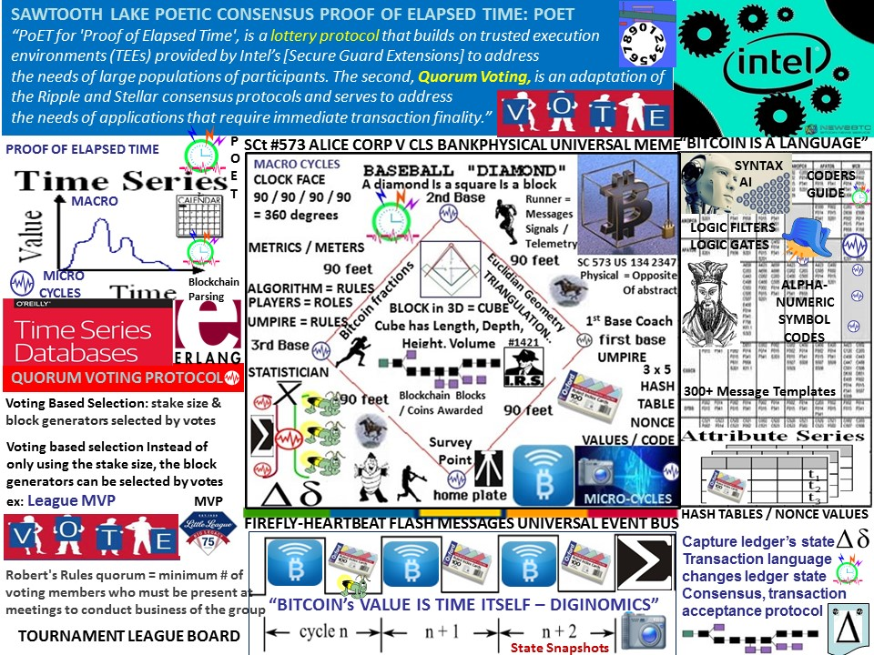

Slide 47
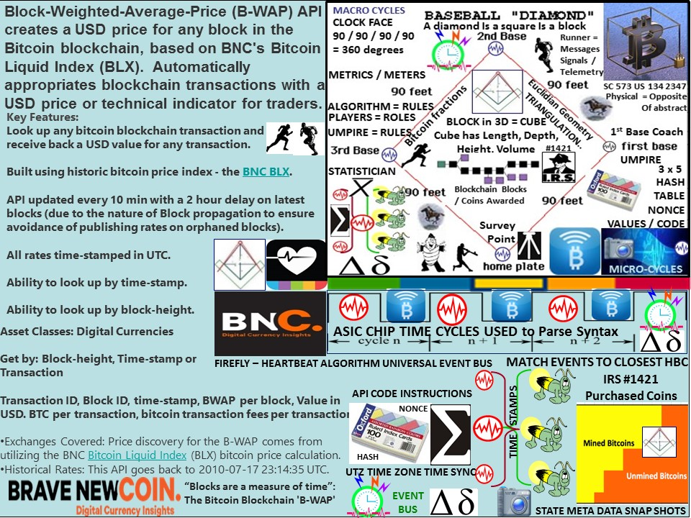

Slide 48
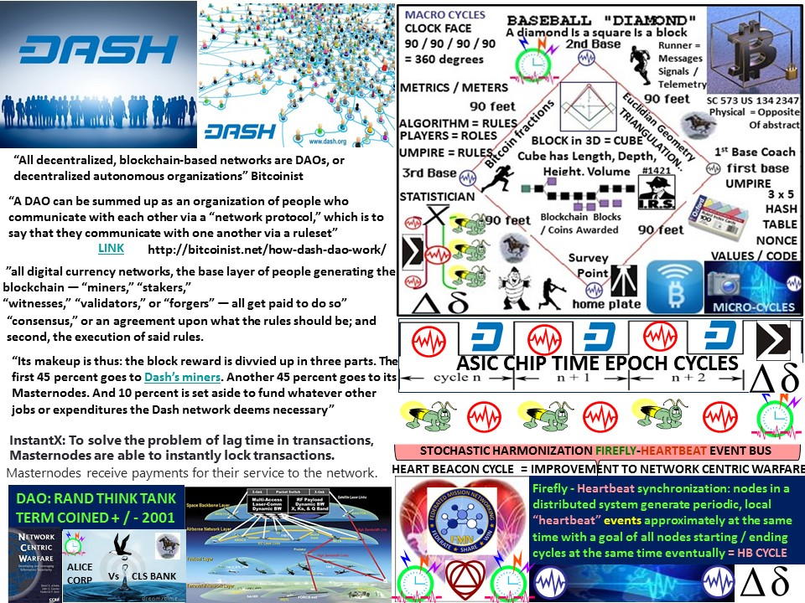

Slide 49
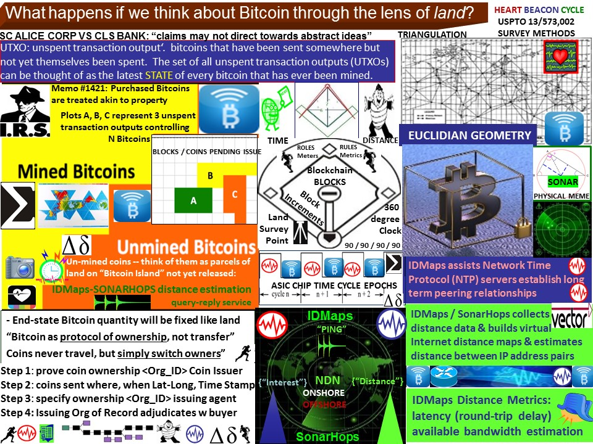
Notes:
Bitcoin Valuated using land meme. IDMaps and SonarHops triangulation will be useful in surveying the Bitcoin landscape in land as a metaphor for value paradigm. In the end-state the quantity of bitcoin will be fixed, just like land. Bitcoin is not perfectly fungible, neither is land. Bitcoins are not ‘consumed’ through use – just transformed. transferred. This is similar to land and dissimilar to many commodities, that are consumed, degraded) through use. "Bitcoin is not a protocol of transfer, but a protocol of ownership. Coins never travel, but simply switch owners”. IDMaps / SonarHops help construct the (Dymaxian maps) of land that visually show how much of the Bitcoin has been mined / issued. Battlefield digitization data is often shown on maps as appliqué overlays in military speak and involves cyclic state meta data refresh from micro to macro (economic, ecological harvesting etc) cycles. Battlefield digitization best practice aids this procedure:
Step 1: prove coin ownership <Org_ID> Coin Issuer
Step 2: # coins sent where, when Lat / Long, Time Stamp
Step 3: specify ownership <Org_ID> receiving entity ; organization Bitcoin type <URN>

Slide 50
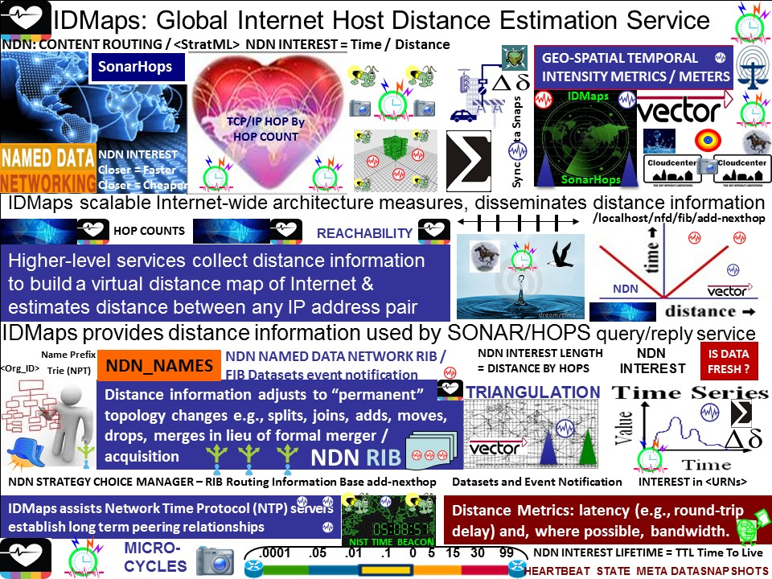
Notes:
IDMaps is a global internet host distance estimation service that provides distance information used by SONAR / HOPS query / reply service. IDMaps meaures and disseminates internet wide distance information to for example, Distributed Autonomous Virtual Organizations DAVOS. Higher level services for example at the macro-cycle level collect distance information to build a virtual distance map of internet by estimating distance between any IP address pair. Location is achieved through use of triangulation Distance information adjusts to “permanent” topology changes e.g., splits, joins, adds, moves, drops, merges in lieu of formal merger / acquisition. IDMaps assists Network Time Protocol (NTP) servers establish long term peering relationships. Distance Metrics focus is on latency (e.g., round-trip delay) and where possible, bandwidth. Stochastic harmonization is improved through use of firefly inspired algorithms that strive to achieve synchronization in a cloud matched with the closest matching heartbeat snapshot cycle interval. Read about IDMaps / SonarHops here
READ ABOUT THE NAMED DATA NETWORK Next Generation Internet HERE http://named-data.net/wp-content/uploads/2014/07/NFD-developer-guide.pdf

Slide 51
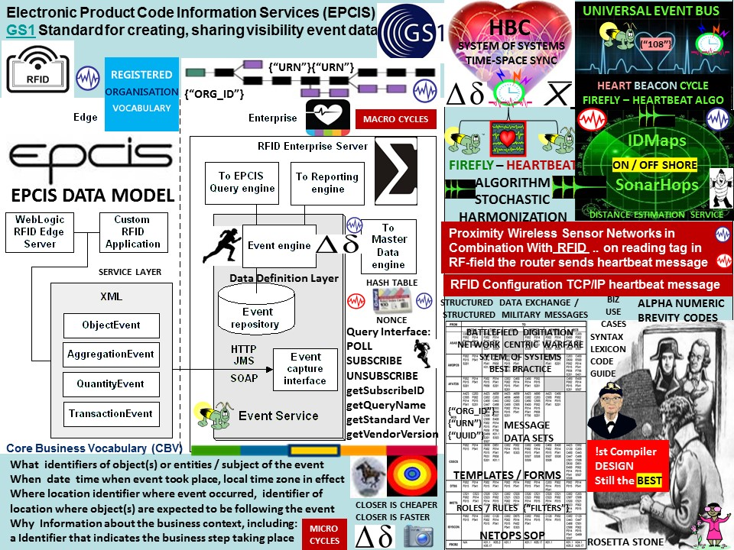

Slide 52
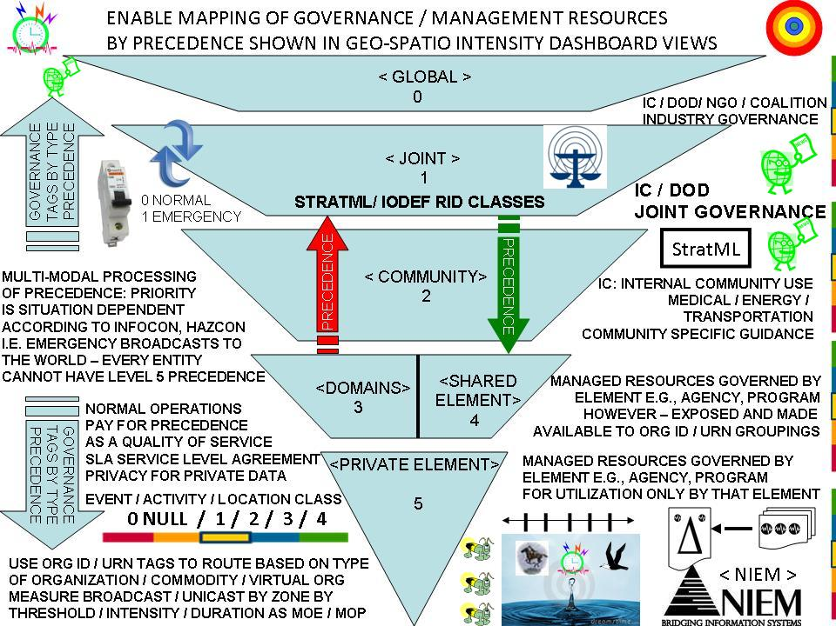
Notes:
Strategy Markup Language (StratML) is an XML-based American national standard vocabulary and schema for the information commonly contained in strategic and performance plans and reports. The vision of the StratML standard is: A worldwide web of intentions, stakeholders, and results. Its more explicit purposes include enabling strategic alignment through literal linkages between performance objectives and the business records supporting them.
The Incident Object Description Exchange Format (IODEF) defines a common XML format for document exchange, and Real-time Inter-network Defense (RID) defines extensions to IODEF intended for the cooperative handling of security incidents within consortia of network operators and enterprises. This document specifies a transport protocol for RID based upon the passing of RID messages over HTTP/TLS (Transport Layer Security).
A systemic adaptive procedural template method improving search engine methods using heartbeat, beacon signaling, <ORG_ID>, <URN>, <class_types>, Paul Revere, water drop in pond meme metric recalculations occurring at off site connectors, conversion relay gateways where detection of trigger point function recalculations of state meta data set aggregations are
used to detect threshold fluctuations by resource <class>, <type>, quantity, availability duration etc., further used to improve geo-spatial temporal descriptive mapping methods, changes in clusters of objects, entities, artifacts i.e., location, epoch time stamp geo-spatially, temporally, used to locate, search, then group into virtual collections using <data_tags> i.e., <rare> in spatial econometric, volumetric operations within network mesh fabrics triggering news-casting invitations to join equitably metered federated group arbitrage events, activities that are triggered by internet search operations improving collaboration, metrics and metering in for example, commodity, fungibles trading, resource pooling, crowd sourcing, contributory economics.

Slide 53

Notes:
The Situational Awareness Reference Architecture (SARA) Guide is intended for industrial facility owners and operators as an open source guide to establishing and maintaining situational awareness. SARA is broken down into four key areas: Identity;Inventory; Activity; and Sharing. For each of these areas no-cost open source solutions are provided to allow facility owners and operators of any size or resource level to achieve a complete set of necessary capabilities. Commercial Solution Provider offer for-cost solutions which enhance each area to allow facility owners and operators to choose where appropriate options which provide greater functionality, professional support and services, and other incremental benefits. Modern society is underpinned by an interdependent infrastructure supporting the services necessary functions. Systems which provide energy, food, water, goods, services, transportation, communication and other services rely on the availability of the others. Each of these infrastructure segments are increasingly controlled by cyber systems which improve their economic and functional effectiveness. These cyber systems bring with them changes to the risks faced by infrastructure operators and those who depend on them. Addressing these risks requires individual facilities and the aggregate infrastructure they are part of to improve the ability to maintain situational awareness.
An application of IDMaps / SonarHops is locating data of Named Data-Networking <interest> by survey methods / internet triangulation denoting events and alerts in a common geo-spatial temporal intensity metric / meter meme e.g. "Paul Revere" hop by hops for linear, sequential data and "Water Drop" for radius, area spatial intensity and frequency. . The Random Number Cyber Beacon from NIST adds an audit feature useful for forensic analysis such as verifying the authenticity of a document, ledger, message or contract at any point in the future.
The Heart Beacon Cycle is a procedural template / document guide referring to detailed treatises guiding the formation, support of federated groups involves use of a commonly agreed upon set of <XML> tags that describe data in a consistently recognizable, understandable meme across cultures, languages, nations and domains -- the provice of an information exchange model for example, the (inter) National Information Exchange Model or NIEM. The above graphic is cyber-security centric. However, common <tags> must be cross-domain effective and able to connect domains, states, nations -- universally. A shared, common semantic web <tag> repository / template library would greatly enhance information / data exchange among federated groups – a Rosetta Stone for Cyber Security, Health Care etc., Named-Data Networking NDN is the next generation internet sponsored by the National Science Foundation NSF. The NDN features routing based on content location which would be facilitated by using network survey and triangulation techniques such as SonarHops and IDMaps. Network Centric Warfare research over seveal decades has generated message templates and tag libraries containing over 300 XML-MTF message templates that could be repurposed for OOTW – Operations Other Than War in military speak or commercial domain applications. Tag / Template libraries need to be cross-walked, normalized, harmonized.. Standardized set of templates / <tag> repositories made available along with a “Rosetta Stone” of instructions of converting values between communities – a task that the National Information Exchange Model is promulgating internationally.. OASIS is a logical international organization already involved in developing a "Rosetta Stone" of course.

Slide 54

Notes:
Since the Heart Beacon Cycle is reuse of military best practice derived from Network Enabled Operations / Mission Aware Networking, it follows that the most useful aspect of this iterative, cyclic process is facilitating individuals joining groups -- keeping in mind that military's almost always do things in groups / organizations. Leader's decision within the federations may cause changes in network state sub-net configuration that must be advertized or broadcast among other participating organizations. Synchronization maintains situational understanding over distances (space) and over time from operation to operation, cycle to cycle. While useful within a single system, the intent is to replicating a proven, cyclical process among a system of systems supported by a network of networks within a FEDERATION.
WIKIPEDIA: FEDERATION: A federation (from Latin: foedus, gen.: foederis, "covenant"), also known as a federal state, is a political entity characterized by a union of partially self-governing states or regions under a central (federal) government. In a federation, the self-governing status of the component states, as well as the division of power between them and the central government, are typically constitutionally entrenched and may not be altered by a unilateral decision of either party, the states or the federal political body. Federations may be multi-ethnic and cover a large area of territory (e.g. United States or India), although neither is necessarily the case. The initial agreements create a stability that encourages other common interests, reduces differences between the disparate territories, and gives them all even more common ground. At some time this is recognized and a movement is organized to merge more closely. At other times, especially when common cultural factors are at play such as ethnicity and language, some of the steps in this pattern are expedited and compressed. The federation of cloud resources is facilitated through network gateways that connect public or external clouds, private or internal clouds (owned by a single entity) and/or community clouds (owned by several cooperating entities); creating a hybrid cloud computing environment.

Slide 55


Slide 56

Notes:
NEW MODEL: TRADE FEDERATION ON THE BITCOIN BLOCKCHAIN
A book review on the book "Blockchain, Blueprint for a New Economy by S.U.M Startup Management dot Org cites: “Bitcoin is the instantiation of decentralization as a digital currency, but decentralization could be instantiated in many ways, such as smart property, delegate democracy governance services, and community-based credit bureaus. Decentralization concepts are already underway in government (Rescaling the State) with a focus on the important role of mayors as non-partisan administrators (If Mayors Ruled the World), and the rise of metropolitanism (21st Century is the Metropolitan Century and Metropolitan Revolution). These ideas could be deployed in more detail per several key properties of blockchain technology in government services, for example its being secure, decentralized, scalable, universal, granular, auditable, trackable, and transparent.
Source: http://startupmanagement.org/2015/02/11/book-review-blockchain-blueprint-for-a-new-economy/ LINK
Source: http://futurememes.blogspot.com/2015/04/blockchain-government.html LINK

Slide 57

Notes:
TradeNet: programmable internet of money, Trade Federation on the Bitcoin blockchain. Keys to establishing Tradenet is use of cyclic, reliable, iterative time cycles to process computational syntax drawn from a common syntax library -- a lexicon repository of brevity codes, data class types -- a TRADENET Rosetta Stone
Mike Hearn, a U.K.-based Bitcoin developer who used to work at Google and now gives talks imagining a future economy driven by something called the TradeNet — a kind of giant automated marketplace, a crypto-secure mashup of Yelp, Craigslist, Uber, and eBay. The key to implementing a Tradenet System is the blockchain—a distributed method of tracking and transferring assets online without need of a trusted third party (such as a bank). Today, there is only one blockchain-based system widely used - Bitcoin itself. Backchannel LINK Bitcoin and the blockchain function as a medium of exchange, a store of value, a unit of account. Bitcoin adds digital, cryptographic, distributed server functions to currencies. Because it functions simultaneously as a currency, an asset and a platform, Bitcoin is better described as a global cryptoCAP (currency, asset, platform) -- a synergistic form of "crypto-capital" to unleash the full economic power of the networked age. Bitcoin makes money programmable. “MONEY IS SIMPLY DATA” - a simple way to measure and keep track of exchanges in value and wealth accumulation. Bitcoin aggregates data in a distributed global ledger accessible to anyone, and software. It is the first open platform for financial services. Color coins represent stocks, bonds, currencies, properties. Source: Wired Magazine Reid Hoffman Why the blockchain matters

Slide 58

Notes:
Institute for Blockchain Studies: the blockchain is essentially a public ledger with potential as a worldwide, decentralized record for the registration, inventory, and transfer of all assets—not just finances, but property and intangible assets such as votes, software, health data, and ideas
‘Blockchain: Blueprint for a New Economy’, is a book that considers theoretical, philosophical, and societal impact of digital currencies and blockchain technologies. It takes one beyond the currency and smart contracts to show how the blockchain is in position to become the fifth ground breaking computing paradigm after mainframes, PCs, the Internet, and mobile/social networking. Melanie Swan discusses concepts, features, and functionality of Bitcoin and the blockchain, using the blockchain for automated tracking of all digital areas, creating a decentralized digital repository to verify identity. The blockchain has the potential of being a worldwide, decentralized record for the registration, inventory, and transfer of all assets: finances, property, intangible assets such as votes, software, health data, and ideas. The book comprises such topics as creating cheaper, more efficient services traditionally provided by nations, making better use of the data-mining network. The book includes how blockchain technologies could be used to monitor public health, crowdfund projects, provide community supercomputing, upload personal mind-files, and even birth artificial intelligences. LINK
Network Economies: Economic System as a Configurable Parameter https://lnkd.in/bFMwAyp Examples of decentralized p2p network concepts have been Tor, Napster, the Internet itself, and also now Bitcoin, cryptocurrencies, and blockchain technology. One way to implement the direct model is through micropayments, where users click on icons to allocate pre-specified amounts of Bitcoin or token to take community actions. The central issue in decentralized p2p content systems to be prototyped and tested is user willingness to micropay for content operations. Economic System as a Configurable Parameter
Datt.co is engaged in developing a software platform for decentralized content hosting communities. Conceptually, this could be like a standalone decentralized reddit. The software platform could also be deployed by existing centralized content communities (like Stack Exchange and Stack Overflow) as an offered parameter at the launch of new communities. Community participants or facilitators could choose the economic model for their community, either 1) advertising-supported (the centralized indirect model), or 2) peer-supported (the decentralized direct model). Other web properties could experiment with this platform to test both kinds of economic models, for example offering private-labeled decentralized versions of Instagram, Twitter, etc. Already-existing blockchain-based decentralized versions of social networking properties like Twister, Gems, Reveal, and BitCloud could further extend their functionality with the decentralized content-hosting platform.

Slide 59

Notes:
CYBER BEACON / HEART BEACON CYCLE METHOD SYNERGY:
NIST is implementing a prototype source of public randomness. The prototype (at https://beacon.nist.gov/home) uses two independent commercially available sources of randomness, each with an independent hardware entropy source and SP 800-90-approved components. The Beacon is designed to provide unpredictability, autonomy, and consistency. Unpredictability means that users cannot algorithmically predict bits before they are made available by the source. Autonomy means that the source is resistant to attempts by outside parties to alter the distribution of the random bits. Consistency means that a set of users can access the source in such a way that they are confident that they all receive the same random string.
Description: The Beacon will broadcast full-entropy bit-strings in blocks of 512 bits every 60 seconds. Each such value is time-stamped and signed, and includes the hash of the previous value to chain the sequence of values together. This prevents all, even the source, from retroactively changing an output packet without being detected. The beacon keeps all output packets and makes them available online. Uses: Tables of random numbers have probably been used for multiple purposes at least since the Industrial Revolution. The first published table appears to be by the English statistician L.H.C. Tippett. In the digital age, algorithmic random number generators have largely replaced these tables. The NIST Randomness Beacon expands the use of randomness to multiple scenarios in which the latter methods cannot be used. The extra functionalities stem mainly from three features. First, the Beacon-generated numbers cannot be predicted before they are published. Second, the public, time-bound, and authenticated nature of the Beacon allows a user application to prove to anybody that it used truly random numbers not known before a certain point in time. Third, this proof can be presented offline and at any point in the future. For example, the proof could be mailed to a trusted third party, encrypted and signed by an application, only to be opened if needed and authorized. NIST encourages the community at large to research and publish novel ways in which this tool can be used. A few examples of applications are described below:
FEDERATION: several parties have private inputs; they wish to compute a function of these inputs without compromising the privacy of the inputs. "authenticated broadcast" of Beacon used as secure multiparty computational solution
- “challenge-response protocol”. The need for both parties to be assured that the other does not control the challenge is critical for security.
UNPREDICABLE SAMPLING: UN-RIGGED REWARD SYSTEM: protecting against industrial sabotage, assuring quality control, preventing clandestine protectionist measures, ensuring accuracy of environmental testing, reward systems, prize awards, donations to charity etc.
SEE: http://nist.gov/itl/csd/ct/nist_beacon.cfm

Slide 60

Notes:
The Mesh Why The Future of Business is Sharing by Lisa Gansky http://meshing.it/book
The mesh is a major trend which will shape business in the next decade.
Military's organize individuals into groups for a purpose very well. Net Centric Operations monitors the “eaches” evaluating if a group is mission ready -- i.e., has met given thresholds -- funding levels using a time tested cyclic, iterative procedure. A military squad must have n members or it is not reported as a unit. The unit must collectively have a certain percentage of health, ammo, fuel, food.. or funds (collected) or it is not considered a unit. If a unit fails to report after n cycles, it is considered “stale” or non-mission capable. Adding simplistic metrics and meters to this cycle in terms of reporting significant changes in a reporting cycle – the sync delta will help crowd funding operations to be operated consistently across a distributed system of systems. Meters and metrics are novel and useful in monitoring time - space sync deltas.
Adding methods to identify a potential crowd based on subscriptions (like the Internet of Things, Net Centric Warfare is a publish-subscribe paradigm) in a geo-spatial area over time using net geo-spatial temporal intensity techniques will help decision makers decide if an a given crowd in a specific geo-spatial area in a telco mesh fabric is worth pursuing prior to other crowds in other areas. Monitoring individual contributions to groups in context with an event by <Organization_Identifier> or </Org_ID> will help form supporting cloud federations. Identifying assets donated to a cause by Uniform Resource Name </URN> will help data analytics and aggregation activities leveraging a cyclic, iterative micro - macro cycle method.

Slide 61

Notes:
The internet based on time cycles used or not used to process instructions as syntax. Instructions are often workflow rules / procedural logic used to route data to nodes on the net as a broadcast or in a particular order as workflows. Software Defined Networking is characterized by RULES / ACTIONS and statistics sampled during time cycles to plan action and reaction to network conditions and node conditions that are shaped by leader’s decisions. Software Defined Networking SDN is usually broadcast or multicast traffic based. Policy controls are used to shape network conditions. Time cycles are used to examine data context by monitoring and examining flow tables for data </tags> and data flows during assigned TIME SLOTS in TIME SLOT SWITCHES. Virtual LAN ID’s identify groups and organizations.
Net Centric Warfare / Net Enabled Operations NEO are similar. The syntax and lexicon used isn’t exact but it could be or terms could be accepted to be equivalent in terms of policy processing rules. Net Centric Warfare’s value is in established procedures / rule sets and an established lexicon in the form of over 300 message sets that describe syntax as data tags to describe data exchanges useful over a wide range of operational, logistics, and intel use cases. These message sets as part of the military’s structured data exchange regimen could be repurposed for commercial use across many domains.

Slide 62

Notes:
IBM / SAMSUNG ADEPT Autonomous Decentralized Peer-to-Peer Telemetry compared with Net Centric Warfare / Operations conventions
ADEPT Autonomous Decentralized Peer-to-Peer Telemetry left / compared with Net Centric Warfare / Operations conventions on right hand side of graphic
Applying the blockchain concept to the Internet of Things is the result of a decentralization study. ADEPT uses the blockchain, TeleHash, and BitTorrent. Telehash is peer to peer messaging. BitTorrent supports distributed file sharing and analytics reports. The Bitcoin Blockchain is used for device communication and transactional coordination. Ethereum in particular performs the contract telemetry between devices. Ethereum "ether" controls the use of roles and responsibilities, permissions, bartering and negotiations among nodes and devices on the blockchain which makes the devices almost completely autonomous. Autonomous devices / nodes can become revenue generating opportunities in their own right e.g., participate in crowd funding, near real time opportunistic auctions or not. Military's operate in a decentralized mode of operations monitoring the status of individual platforms, devices, individuals that are organized into groups identified by a Organization Identifier <Org_ID>. Devices, platforms, sensor types are identified by Uniform Resource Name <URN>. In the Heart Beacon Cycle scenario, the device's ID typed by Uniform Resource Name <URN> would be affiliated to an organization <Org_ID> so individual devices belong to a trade or cooperative federation would be monitored for aggregate mission readiness and eligibility for group discounts, priorities, or group preferences supported by workflow logic telemetry according to need or contractual Service Level Agreement.

Slide 63

Notes:
The Heart Beacon Cycle idea / invention facilitates the forming of agile, adhoc federations in lieu of formal mergers and acquisitions, then, it provides a simple framework for exchanging state meta data snapshot changes in for example, distributed ledger values across the diverse systems of systems of Bitcoin and current currency, stock, commodity.. systems and provides metrics / meters useful in establishing smart contract Service Level Agreements. CREDIT TO: COIN TELEGRAPH ARTICLE

Slide 64

Notes:
THE BITCOIN Community has four major issues: Volatility, Inconsistent Memes, Identity, and lack of intrinsic value. The Heart Beacon Cycle addresses all four issues systemically. The TERRA Trade Reference Currency is a paper / document proposal that lacks a transaction protocol like Bitcoin. Regardless of what solution emerges, legacy and local solutions / currencies (SWIFT / FIX, local currencies) will persist for decades. Battlefield Digitization / Network Centric Operations is designed to foster collaboration across organizations, systems, network and space / time zones. The world should examine potential synergy among Bitcoin technology, the TERRA TRC and Battlefield Digitization. A systems of systems approach is needed to address backwards compatibility, interoperability and synchronization of systems across space and time zones. The TERRA Trade Reference Currency, Ethereum, and Battlefield Digitization commercialized (Heart Beacon Cycle) all involve maintaining globally distributed ledgers. Battlefield Digitization best practice provides procedural templates describing as guides, the when, where, how and how often systemically among a systems of systems promoting synergy.
Neuroware Launches 'Future-Proof' API for Cryptocurrency Apps: Building an infrastructure that is easy-to-use is critical if the digital currency ecosystem wants to encourage the creation of consumer-facing products. To simplify this process, startup Neuroware has built Blockstrap – an application programming interface (API) for web designers and front-end developers that supports bitcoin and other cryptocurrencies, allowing developers who want to create well-designed crypto-based apps to plug into its HTML5 framework. Adam Giles, CEO of Neuroware, explained that the goal is to create a blockchain-agnostic resource for those who are looking to build new products and services, and that the project itself came out of his own difficulties building a product with existing resources.
PROJECT STELLAR: Stellar, the long-secret digital currency project helmed by industry entrepreneur Jed McCaleb, has officially launched. McCaleb is the original founder of defunct Japanese bitcoin exchange Mt. Gox and a co-founder of digital currency-focused payment network Ripple Labs. The new platform is a decentralized gateway for digital currency to fiat currency transfers, The Wall Street Journal reports. Like Ripple and bitcoin, Stellar will act as a public transaction authenticator and feature its own in-house digital currency called ‘stellar’. McCaleb’s announcement follows months of rumors about the project, which first surfaced in February. At the time, a mysterious website was launched to enlist developers, alpha testers and designers, and now redirects to the official Stellar site. In a statement, the Stellar Development Foundation’s Executive Director Joyce Kim suggested that Stellar will act as a bridge between fiat and digital currencies – a key requirement if the latter are to be adopted by mainstream users. Stellar details. According to WSJ, Stellar will act as a transaction gateway, enabling usability in both fiat and digital currencies. While it’s not clear what, if any, infrastructure is already in place, Stellar, like Ripple, will allow cross-border transactions that use digital currency as a technological ‘middleman’ for fiat transfers. http://www.coindesk.com/mt-gox-ripple-founder-jed-mccaleb-unveils-project-stellar/ Notably, the platform’s in-house currency, stellar, will be distributed to users for free. Supply is capped at 100 billion units, with roughly 95% of this amount being given away.

Slide 65


Slide 66

Notes:
Smart energy grid protocols use heartbeat, heartbeat messages for example IEC C37.118 Harmonization and Synchronization is used across smart grid applications andspecifies a heartbeat update interval in milliseconds -- depending on the time sync source. Micro-grid use is set to increase dramatically in both military and commercial applications. The ability to accurately, reliably and consistently meter changes in power consumption between a community specializing in micro-grid energy production and a community specializing in a ecology module purifying water or producing bio-mass can monitor usage in terms of surpluses or shortages based on the last sync delta update across a trade federation / consortium as a basis for exchange e.g., electricity for water or food or fuel etc.

Slide 67

Notes:
Big Data analytics, network forensics will never reach their full potential until data is synchronously, reliably time stamped prior to data fusion center insertion -- using Organizational Identifiers as a primary key or secondary key used to track organization, URN Uniform Resouce Name typed resource movement from one micro-cycle to the next forming reports that are aggregated, filtered by precedence, then fused to inform decision makers of changes in micro-cycles viewed in longer, slower operational macro-cycles. Novel time-space meters / metrics i.e., the Paul Revere for linear, sequential hop counts from cloud center to cloud center or computer server node to node or the water drop radius, circular meme to measure changes in movement, geo-spatial temporal intensity in universally recognized memes will help identify unused resources with unmet needs establishing a universal time -space meter framework for the Internet of Everything IET helping realize the goal of "gaining the ability to hear the world's heartbeat"

Slide 68

Notes:
A systemic adaptive procedural template method used to improve handicapped / information alerts, events, methods reliant on heartbeat timing, signaling synchronization of state meta-data improved using Paul Revere, water drop in pond memes to create, calculate radius, intensity metrics viewed as geo-spatial, temporal intensity effects i.e., visual light bar tabs i.e., stock
exchange candlestick charts, audible tone, vibration-tactile situational awareness alerts by correlating tone based messaging precedence XML <tag> where lower / higher precedence settings equate to lower / higher audible tones, tactile vibrations for deaf where fewer / greater number of light tabs lit correlates, corresponds to priority, precedence <tags> further used in alert triggers of threshold fluctuations displayed in appliqué overlay graphics as metrics, meters. Using heartbeat signalling, time stamp record keeping processes of state meta data described, typed by organizations, resources typed by Uniform Resource Name, further improved through use of Paul Revere, Water Drop in Pond memes to quantify, describe unused resources with unmet needs by performing recalculations of state meta-data snapshot artifacts occurring at off site connector conversion gateways where micro-cycle reports from local, micro-cycle activities are signalled, relayed to higher echelon organizations monitoring macro-cycles who are interested in for example stock market "pools" where "output" is correlated and displayed onto appliqué views of aggregate sync delta changes in macro-micro economics recalculations i..e, stocks, commodities, currencies, interest rates, electric micro-grids, currency (Terra) exchanges, spatial econometrics, and contributory economics

Slide 69

Notes:
Military command, control, communications, intelligence systems typically use structured military messaging formats that have a message precedence field that corresponds to changes from a null state to indicated priority processing. The number of precedence levels is arbitrary i.e., null, elevated, imminent such as the current Department of Homeland Security Alert System that is 3 levels making it incompatible with military systems that are typically five levels. 3 / 5 = 1.666 – not a 1 :1 match / correspondence for message parsers (processors) requiring human intervention to sort the message out in a cue as to which precedence is desired – a procedure that defeats the process of using numerical levels in the first place.

Slide 70

Notes:
Heart Beacon Cycle Big Picture: sample environment publish-subscribe process where changes to state meta data is collected then offered by subscribed systems participating in synchronized operations. UCalifornia Berkeley Sea Gull protocol is cited as one example out of many. Homeland Security Advisory system when it was five levels (now three levels: null, elevated, imminent) as an example of alert levels that serve as a model to map data processing by precedence levels – in concert with most other national, global alert beacon type event systems

Slide 71

Notes:
SCOP: an example tool used to configure heartbeat intervals
SCOP: a tool used to configure heartbeat intervals / heartbeat message parameters. In reality, there is no heartbeat or beacon -- or packets, frames etc. The reality is that the internet is based on cyclic time intervals that serve as opportunities in time to do / not do computational tasks. If and when the world realizes the role of time in context with the internet, use of time cycles will (finally) become the common building block to build our world in an equitable, reliable, CONSISTENT manner. Not acknowledging the internet as metering, measuring time cycles leads to endless hype cycles: HYPE CYCLE: http://en.wikipedia.org/wiki/Hype_cycle The Hype Cycle is a branded graphical tool developed and used by IT research and advisory firm Gartner for representing the maturity, adoption and social application of specific technologies.

Slide 72


Slide 73


Slide 74

Notes:
Waiting for the Bitcoin Blockchain wars to begin.. Supreme Court "claims may not direct towards abstract ideas" The opposite of abstract is physical. The Heart Beacon Cycle Time - Space Meter patent application's main embodiment is a physical, Little League Baseball Tournament meme. All things internet, internet of money / value are formed using
1) Time cycle epochs
2) Lexicon syntax as instructions

Slide 75

Notes:
‪#‎Patent‬ filers FYI: abstract metaphors, memes = no go ex: ‪#‎Bitcoin‬,‪#‎blockchain‬, packet, frames, "HEARTBEAT" pings.. above is a summary of patent filings, USPTO actions to date.. the internet is formed using two building blocks: time cycles created by computer chips used to process, parse syntax / code as instructions which SAW Concepts LLC established and the USPTO concurred in 2004. All claims made after 2004 are variations on a theme based on the main embodiment formed by time cycles / syntax -- "In the beginning (of) time, there was the word"...

Slide 76


Slide 77

Notes:
13/573,002 universal symbol data set lexicon for us and for communicating with #ET's AI based on #NATO best practice /#disclosure Alternative history folks are saying that ancient cultures used symbols to communicate for a reason -- because they were empathic and telepathic..... symbols represented as numeric brevity codes is a bridge between AI and advanced intelligence and we clever animals / humans Humanity is building an Artificial Intelligence AI robotic neural network. ET disclosure people are saying that ET's communicate and navigate their ships telepathically. NATO has a structure military messaging library that uses alpha-numeric brevity codes / lists to describe data exchanges during certain situations. Our drones and ET's AI bots would exchange data / telemetry via alpha-numeric brevity codes -- as well as countries on the earth trading -- rather than cumbersome translation between textual languages which is slow, inaccurate and not the way forward..
In establishing the signals and telemetry instruction annex to Buckminster Fuller's Spaceship Earth manual -- WHY REINVENT THE WHEEL? Tweak and modify the current tax payer paid for wheel -- in my opinion

Slide 78


Slide 79


Slide 80


